Slide 1
Thank you for joining us!
Today’s presentation will begin momentarily.
Please feel free to connect with other participants
using the (direct) chat feature while you wait.

Slide 2
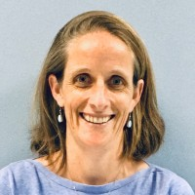
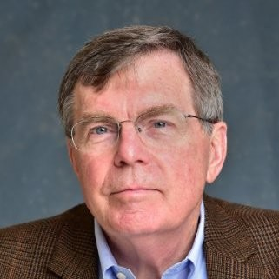
VACCINES – HOW THEY WORK
AND WHY YOU SHOULD GET ONE
Meg Sullivan, MD, MPH
Medical Director
Mecklenburg County Public Health
Patrick Robinson, MD, MPH
former CDC EIS Officer
APHI Research Professor, UNC Charlotte

Slide 3
Can you provide a brief historical context to pandemics and vaccinations?
Our global history is inextricably linked to pandemics….and the race to prevent them

Slide 4
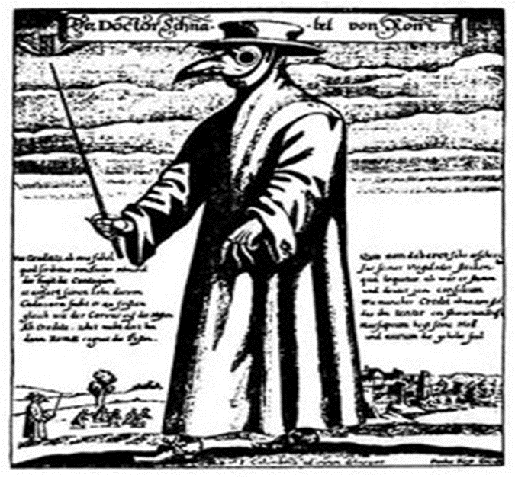
The Plague
Middle (“Dark”) Ages (476-1450 AD)
Death of 25% to 50% of population ... Including 1/3 (~25 million) in Europe and some 60 million worldwide
Originated in Asia, and moved west with Mongol armies and traders
The Italian author & poet Boccaccio said victims “ate lunch with their friends and dinner with their ancestors in paradise”
Notes:
Epidemic disease in Western Europe between 1348 and 1530+ AD (the end of the Middle Ages through the Renaissance)
The Plague (The Black Death)
Worst from 1348-1352
Killed at least 25 million people in Europe (1/3 of the population).
Killed more than 60 million worldwide.
Boccaccio said that the victims, "ate lunch with their friend and dinner with their ancestors in paradise."
Map graphic courtesy of “The Black Death, 1348," EyeWitness to History, www.eyewitnesstohistory.com (2001)
http://www.iath.virginia.edu/osheim/
http://www.learner.org/exhibits/renaissance/index.html
http://www.cdc.gov/ncidod/dvbid/plague/
http://www.insecta-inspecta.com/fleas/bdeath/
http://www.bbc.co.uk/history/society_culture/welfare/black_01.shtml
Background
The plague spread when people fled to other cities. It is believed the plague originated in Asia, and moved west with Mongol armies and traders. The plague traveled on trade routes and caravans. In 1348 a ship docked at in Dorset, England. On this ship were flea-infested black rats that carried a disease, which was to wipe out almost 33% of the British population. The disease would plague Britain's shores for 300 years, triggering repeated epidemics.
Two main types of fatal plague in this period: pneumonic and bubonic. Pneumonic plague was spread by sneezing and bubonic plague by flea bites. The fleas that delivered the deadly bite would leap from dead rats to humans and could survive in any warm place. Pneumonic fever was more contagious because it was air-based. Symptoms of bubonic plague would start with a high temperature, headaches and vomiting, followed by lumps appearing in the groin and armpits. Eventually the victim would be covered all over with black bruises; death would shortly follow.
Such a devastating disease was bound to bring huge changes to medieval society. Some writers complained the disease had brought out the worst in people. In other cases, because so many had died, labor was in short supply.
In 1346, the Plague came to Kaffa, a Genoese cathedral city and a port central to the successful Genoese trade industry located on the Crimean Peninsula of the Black Sea. The Tartar forces of Kipchak khan Janibeg, backed by Venetian forces - competitors of the Genoese - had laid siege to Kaffa in hopes of removing the Genoese from one of the cornerstones of Europe's defense against Eastern attack and Genoa's dominance of east-west trade. Kaffa was helpless, barely able to sustain even the crudest living conditions. Finding its chief means of supplies cut off, Kaffa spent the next year watching itself decline into a hopeless state. "But then, in 1347, to the Italians' delight, their opponents began to die off at an alarming rate - Janibeg's army was overcome by the Plague. Janibeg had no choice but to call off his siege, but not until he performed one last act of warfare against Genoa. "Using the catapults designed to throw boulders and fireballs over the walls of fortified cities like Kaffa, Janibeg launched the Plague-infested corpses of his dead men into the city. The Italians quickly dumped these bodies back into the sea, but the damage was done. Due to the squalid conditions forced upon Kaffa by the siege, it was ripe for the quick desolation of the Plague. "Hoping to escape the quickly spreading disease, four Genoese ships, thought to be untainted, departed from Kaffa. They sailed home to Italy." By the time the ships reached Italy, many sailors on board were sick. Now the bacteria could make a foothold in new territories and would soon claim huge numbers of new victims. Such a devastating disease was bound to bring huge changes to medieval society. Some writers complained the disease had brought out the worst in people. In other cases, because so many had died, labor was in short supply.

Slide 5
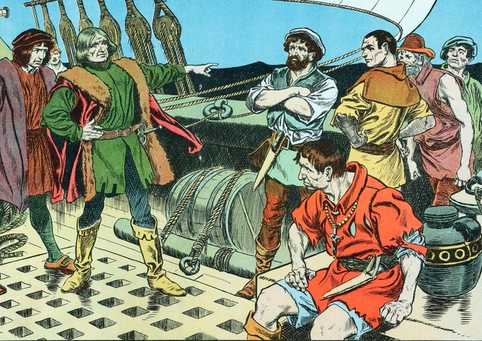
Global Exploration/Renaissance (1400-1600 AD)
Disease, spread by traders and explorers
Killed 90% of indigenous people in New World
Notes:
Into the Renaissance:
Arts and literature and exploration flourished.
Explorers and traders unknowingly spread diseases like smallpox, measles, and typhoid.
This method of the spread of disease still exists today (e.g., spread of SARS across countries, albeit in a very accelerated form).
Background (global disease spread)
“The Spanish inadvertently owe much of their success in conquering the Aztecs and Incas in Mexico in the 16th century to smallpox. Unlike the Spanish, the native Indians had no immunity to the disease, having never encountered it before. It wiped out huge numbers of them. A century later the North American Indians suffered a similar devastation. In the 18th century smallpox decimated the aborigines when it reached Australia, the last corner of the world to have escaped its ravages.”
Source: http://www.bbc.co.uk/history/discovery/medicine/smallpox_01.shtml
Born to Die : Disease and New World Conquest, 1492-1650 by Noble David Cook (1998)
Explains how the conquest of the New World was achieved by a handful of Europeans--not by the sword, but by deadly disease. The Aztec and Inca empires were destroyed by a few hundred Europeans whose most important weapons, though the conquerors did not realize it at the time, were diseases previously unknown in the Americas. The end result of the colonizing experience in the Americas, whether of the Portuguese, Dutch, Spanish, English, or French, was the collapse of native society.
Background (Age of Exploration)
Latter half of the fifteenth through the sixteenth centuries
Genoese navigator, Christopher Columbus (1451–1506)
First English voyage around the world by Sir Francis Drake (ca. 1540–1596)
Vasco da Gama's (ca. 1460–1524) voyage to India, making the Portuguese the first Europeans to sail to that country and leading to the exploration of the west coast of Africa
Bartolomeu Dias' (ca. 1450–1500) discovery of the Cape of Good Hope
Ferdinand Magellan's (1480–1521) voyage to find a route through the Americas to the East, which ultimately led to discovery of the passage known today as the Strait of Magellan
Source: http://www.metmuseum.org/toah/hd/expl/hd_expl.htm
http://www.bbc.co.uk/history/discovery/exploration/

Slide 6
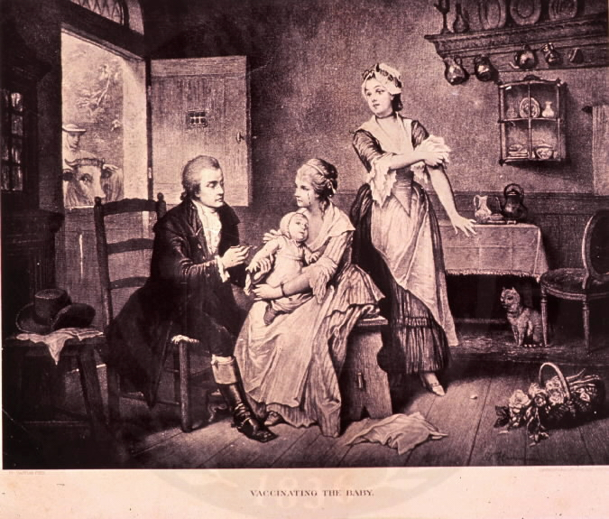
Variolation – intentional infection by inhalation or puncture had death rates of 1-2% versus 30-40% of natural infections
National Library of Medicine
Notes:
National Library of Medicine
Variolation was successfully used in Charleston during the 1738 smallpox outbreak by Dr. James Kilpatrick. Of 441 persons inoculated, 15 died. The death toll was much heavier among those who were naturally infected, so the results of variolation were seen as encouraging. In September, 1738, the general assembly was called into session to deal with the outbreak. By the end of September, the death toll was 295 of 1,675 reported cases. Charleston had fewer than 5,000 residents.
The disease had a devastating impact on Indian communities, as it spread rapidly in a population with no immunity. The Cherokees lost half their numbers during the 1738 epidemic.
John Duffy. (1953) Epidemics in Colonial America. Louisiana State University Press

Slide 7
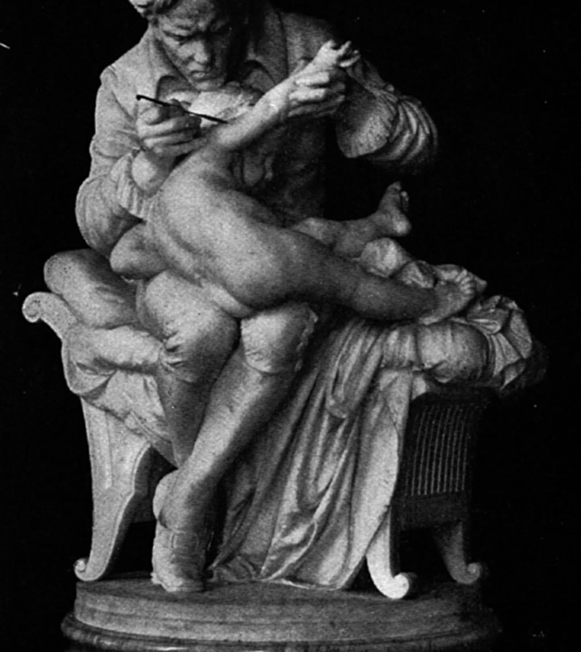
Age of Reason and Enlightenment (1650-1800 AD)
Edward Jenner
1796 cowpox experiment
Coined the term vaccine (vacca, Latin for “cow”)
Inoculated eight-year-old James Phipps with cowpox
Proved that cowpox provided immunity against smallpox
Notes:
A renewed interest in Reason & Enlightenment laid foundation for more scientific explorations
Graphic: statue of Edward Jenner vaccinating eight-year-old James Phipps
Background
William Harvey (English physician, 1578 - 1657)
Demonstrated function of the heart and circulatory system
1628 publication of his theories in “An Anatomical Study of the Motion of the Heart and of the Blood in Animals”
First to suggest that humans and other mammals reproduced via the fertilization of an egg by sperm.
Used dissection (no microscope) to create theories
http://www.bbc.co.uk/history/historic_figures/harvey_william.shtml
Edward Jenner (English physician, 1749 - 1823)
1796 vaccination of eight-year-old James Phipps proved that cowpox provided immunity against smallpox (age-old tradition that people who had earlier caught the mild disease of cowpox did not catch the normally fatal disease of smallpox – on May 14, 1796 Jenner inoculated Phipps with swinepox and on July 1 he inoculated Phipps with smallpox)
Coined the word vaccine from the Latin vacca for cow,
Laid the foundation of modern immunology as a science
http://www.jennermuseum.com/
http://www.bbc.co.uk/history/discovery/medicine/smallpox_02.shtml
http://www.whonamedit.com/doctor.cfm/1818.html

Slide 8
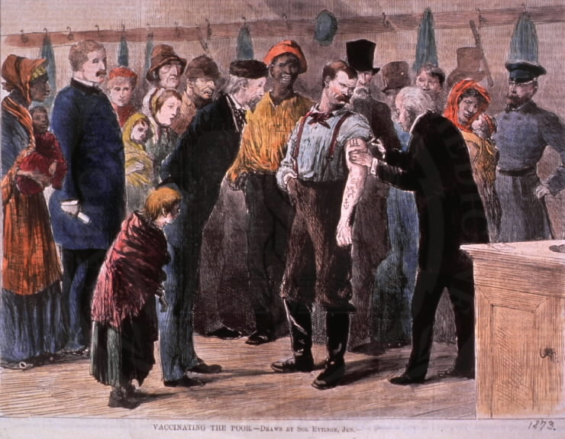
National Library of Medicine
Notes:
Vaccinating the poor, 1873, National Library of Medicine
...the subject of a general vaccination of the people of the State, was, in view of a threatened invasion of small pox, urged upon the Executive Committee by its Chairman in a very able report, and measures were at once instituted to carry this work into effect in as far as the limited appropriation of the Committee, the prejudices of the people, and the non-existence of a compulsory law would permit.
In the Spring, the Secretary was instructed to procure a supply of virus for distribution to the sub-Boards of Health; this was done with as little delay as possible, and non-humanized virus in sufficient quantity was obtained from Wisconsin to supply all counties in the State, and was distributed along with a circular for using it most effectively. Unfortunately, the season was too far advanced, and the presence of the hot weather, rendering the lymph ineffective in a short time, caused the success of the undertaking to be limited.
This engraving from 1873 shows public health in action, vaccinating the poor in New York.

Slide 9
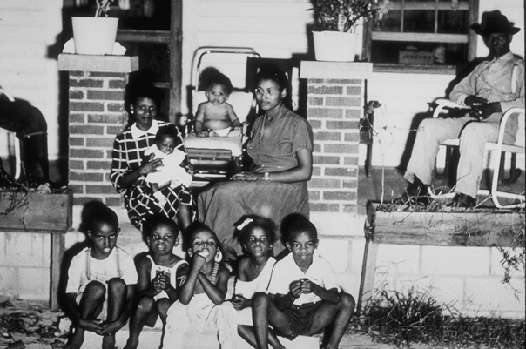
1925 – nearly 1/3 of children in SC die by age 6 (all causes, not just infectious diseases)
“Pox parties” [varicella] were a common practice to ensure young children are exposed, hoping to avoid the harsher complications of infections later in life
Photo: South Carolina Board of Health
Notes:
In fact, a 1925 report on public health conditions found that “nearly one-third of the children born in South Carolina die before reaching the age of six years.”
Donald M. McDonald. 1925. “A Survey of Public Health Conditions in South Carolina.” Bulletin of the University of South Carolina, (No. 159). Columbia, SC: University of South Carolina, Extension Division.

Slide 10
Major Milestones - Vaccines and immunization programs
1798: Smallpox
1914: Tetanus
1915: Pertussis (Whooping Cough)
1923: Diphtheria
1945: Flu (first of annual)
1955: Polio (first of several types)
1963: Measles
1967: Mumps
1969: Rubella
1995: Varicella (Chicken pox)
1963: The Federal Immunization Grant Program (US)
1967 (1958): The Global Smallpox Eradication Program (1977)
1974: WHO Expanded Program on Immunizations
1994: The Global Programme for Vaccines and Immunization

Slide 11
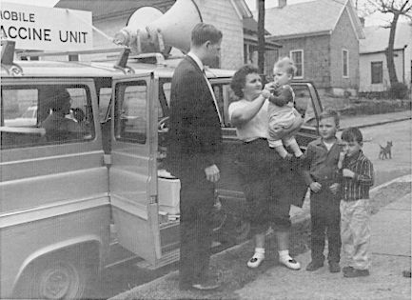
National Library of Medicine
Notes:
Mobile immunization clinics, 1955, NLM
After the development of polio vaccine, major public health immunization campaigns were successfully implemented.

Slide 12
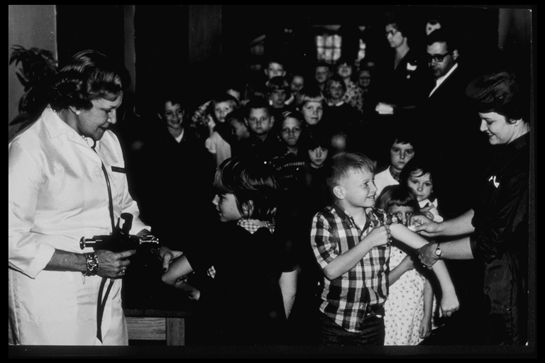
South Carolina Board of Health
Notes:
“3,298 were vaccinated...effectiveness was 60 to 90%... “

Slide 13
Hubris?
The late 20th Century will be witness to the virtual elimination of infectious disease as a significant factor in social life.
Sir Mcfarlane Burnet
Virologist, Nobel Laureate, 1962

Slide 14
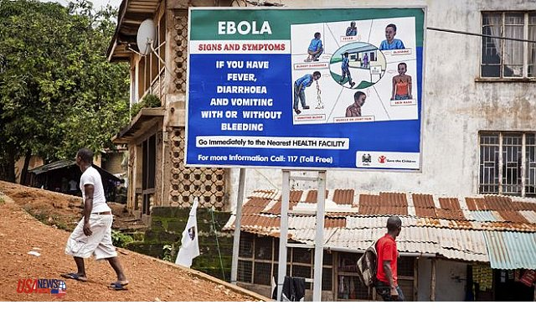
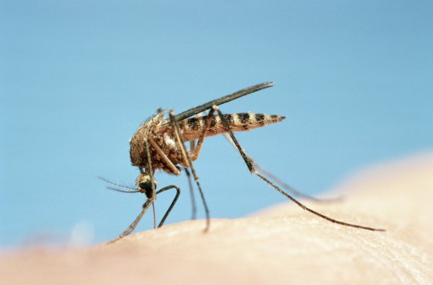
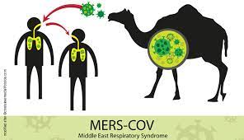
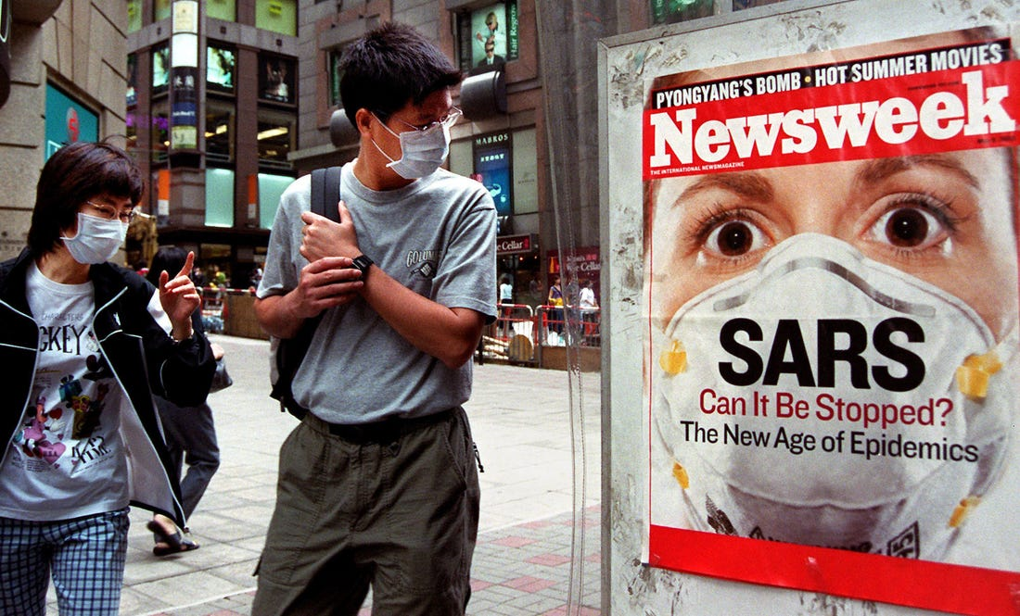
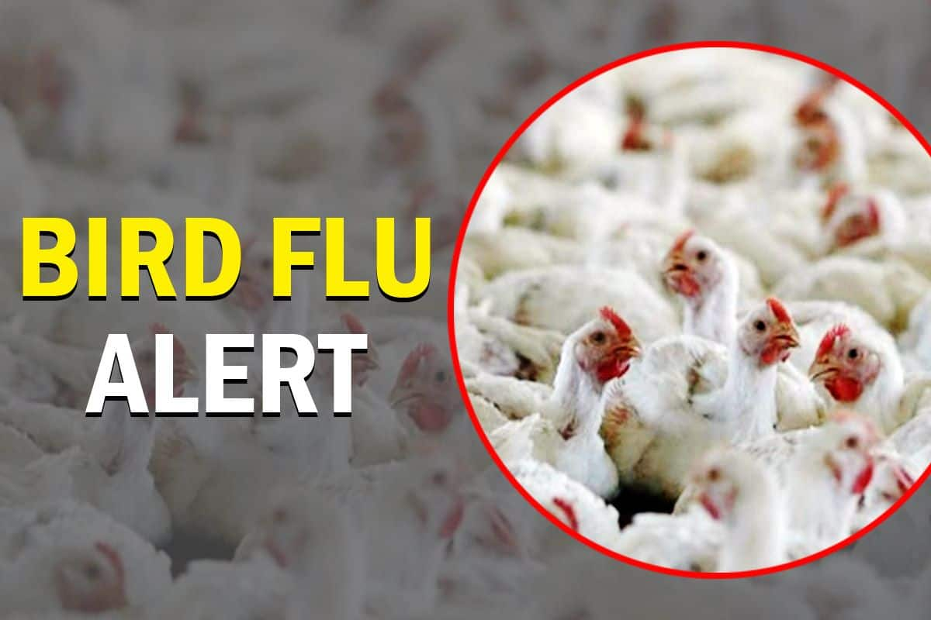
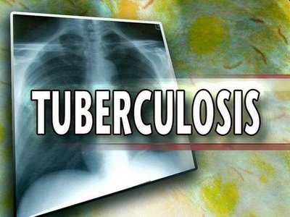
COVID – It was always a question of WHEN, not IF…
1997
West Nile Virus
Malaria
2012
2003
2014
1981
2005 (2021?)

Slide 15
Can you explain the types of vaccines?
It’s all about the ANTIGEN!

Slide 16
The Basic Principles of Vaccines
Every vaccine contains / produces antigens
Complex proteins, sub-proteins, glycoproteins
Antigens are from bacteria/virus
Antigens presented to immune systems
We develop immune responses to protect against antigens
Goal: long-lived immune protection
Minimize adverse vaccine events (side effects)

Slide 17
Five Basic Types of Vaccines
Killed whole cell vaccine
Live attenuated vaccine
Sub-unit vaccine
Virus vector vaccines
mRNA vaccines

Slide 18
“Killed” Whole Cell vaccine:
Grow and then kill the whole organism (virus or bacteria)
https://www.who.int/news-room/feature-stories/detail/the-race-for-a-covid-19-vaccine-explained

Slide 19
Live Attenuated Vaccine:
Grow the virus over and over in conditions that make it weaker and weaker
https://www.who.int/news-room/feature-stories/detail/the-race-for-a-covid-19-vaccine-explained

Slide 20
Sub-unit vaccine:
Only small parts of bacteria or virus are used in vaccine
https://www.who.int/news-room/feature-stories/detail/the-race-for-a-covid-19-vaccine-explained

Slide 21
Viral Vector Vaccine:
Acts like a Trojan Horse
Coronavirus genes
Adv infects human cells
Adenovirus – does not replicate in humans
https://www.nytimes.com/interactive/2020/health/oxford-astrazeneca-covid-19-vaccine.html

Slide 22
mRNA Vaccine: mRNA from virus
Manufacturing the vaccine
Host cells make the antigen
https://www.who.int/news-room/feature-stories/detail/the-race-for-a-covid-19-vaccine-explained

Slide 23
Type | Process | Pro | Con | Examples
Killed whole cell vaccine | Infectious agent grown in vitro, then killed by chemical or heat treatment | “Easy” to develop | Adverse effects | Whole cell pertussis Salk polio vaccine
Sub-unit vaccine | Pathogen is non-viable; contains key antigens. Often produced by recombinant technology; virus-like particles (VLPs) | Fewer adverse effects. High volume manufacturing. | More difficult to make than killed whole cell | Influenza, acellular pertussis, meningitis, typhoid vaccines
Live attenuated vaccine | Pathogen is live but weakened by multiple passages; short-term replication in recipients | May produce longer immunity | May cause infections in immune compromised or contacts of vaccinees | Sabin polio vaccine, influenza nasal spray, MMR
Vector vaccines | Key genes of pathogen are put into live virus vector. Several rounds → produce antigen in host | Potential for highly potent immune response | Difficult to produce; Up till now: little experience | Astra-Zenica and J&J Covid vaccines
mRNA vaccines | Vaccine contains viral mRNA that is incorporated into host cells; directs virus antigen production by host. | Rapid development of vaccines; highly specific antigens; rapid re-tooling | Up till now: little experience | Pfizer & Moderna Covid vaccines – spike protein antigen

Slide 24
Can you briefly explain how our immune response to vaccines works?
It’s a two-stage process:
The innate
The adaptive
Antibodies
Immune cells

Slide 25
Immune Response to Infections and Vaccines
Immunity
Happens!
Antibodies
Protection
Innate
Immune Cells
Invasion of the Antigens
… Adaptive Immunity → →

Slide 26
Innate and Adaptive Immune Systems React to Antigen
Immediate
~10-14 days
https://www.pinterest.com/pin/459648705695380456/

Slide 27
Virus and Host Interactions
Neutralizing abs
ACE 2 receptor & virus spike protein: connection and entry of virus into host cell
Source: Gregory A. Poland. Medscape. accessed 14Apr2021

Slide 28
Can you say a bit more about adverse effects?
Protection: Innate, antibody & cellular immunity
Adverse effects: Innate response (mostly)

Slide 29
Summary of mechanisms underlying the development of reactogenicity.
Innate response
Notes:
Vaccine antigens and immune enhancers (as adjuvants) injected into the muscle are recognised by the body as potential pathogens and/or danger signals. This recognition leads to the stimulation of local cells, followed by the recruitment of blood immune cells to the local site and the production of different soluble factors including vasodilators and cytokines.
Trigger the development of signs and symptoms of local inflammation (pain, redness and swelling).
The passage of some of those factors in the bloodstream, as well as the production of other systemic factors by immune blood cells or distant organs (e.g. liver), may contribute to the development of general symptoms (fever, myalgia, headache etc) in
the vaccinee. CRP C-reactive protein.

Slide 30
Rare Adverse Reactions
Difficult to determine relationship, causality.
Determine risk/benefit.
Recently Suspected with Covid-19 : Central Vein Thrombosis
Taquet et al. Oxford Univ Apr 2021 (not peer reviewed)

Slide 31
Can you explain how vaccine efficacy and vaccine coverage impact community health?
“Public confidence in immunization is critical to sustaining and increasing vaccination coverage rates and preventing outbreaks of vaccine-preventable diseases (VPDs). “
--CDC 2015
https://www.cdc.gov/vaccines/imz-managers/laws/downloads/improving-vax-coverage-factsheet.pdf

Slide 32
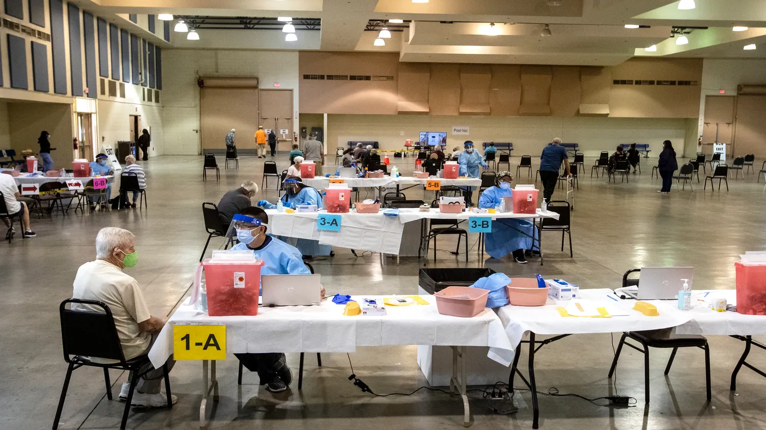
Vaccine Efficacy and Community Health

Slide 33
Vaccines Work! Look at Measles

Slide 34
Question 4
Efficacy: COVID-19 Vaccines
 | Pfizer Vaccine – EUA 12/11/20 | Moderna Vaccine – EUA 12/18/20 | Johnson and Johnson Vaccine – EUA 02/26/21
Vaccine Mechanism of Action (TYPE) | mRNA mechanism | mRNA mechanism | Vector mechanism
Efficacy | 95% | 94.5% | 66.9%
Efficacy Against Severe COVID-19 Illness and Hospitalizations | 75.0% effective against severe COVID-19 illness 7 days or more after second dose 100% effective against hospitalizations from COVID-19 7 days or more after second dose | 100% effective against severe COVID-19 illness starting 14 days after second dose 100% effective against hospitalizations from COVID-19 starting 14 days after second dose | 85.4% effective against severe COVID-19 illness with an onset of at least 28 days after vaccination 100% effective against hospitalizations from COVID-19 with an onset at least 28 days after vaccination

Slide 35
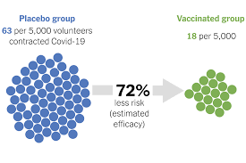
Question 4
“What Do Vaccine Efficacy Numbers Actually Mean”?
https://www.nytimes.com/interactive/2021/03/03/science/vaccine-efficacy-coronavirus.html

Slide 37
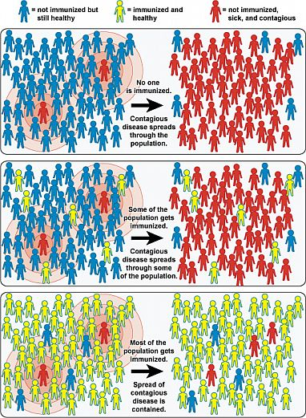
What is Herd Immunity?
NIAID graphic
Notes:
.

Slide 38
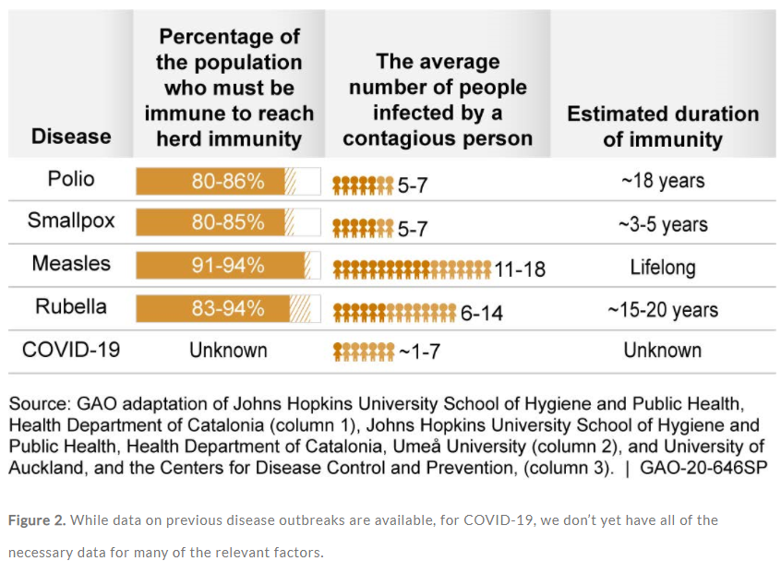
Community Immunity for Specific Vaccines
Science & Tech Spotlight:Herd Immunity For COVID-19
GAO-20-646SPPublished: Jul 07, 2020. Publicly Released: Jul 07, 2020.

Slide 39
What assurances do we have that the COVID vaccines are safe and effective?
Tested, safe, and effective COVID-19 vaccines will help us get back in control of our lives and back to the people and places we love.
--NC DHHS COVID-19 Vaccines 101

Slide 40
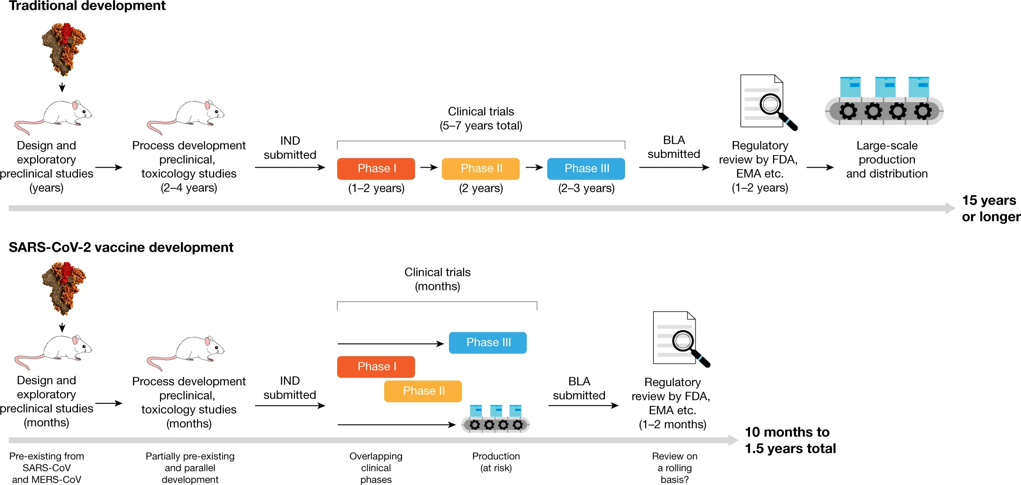
Question 5
COVID-19 Vaccine Development
Krammer, F. SARS-CoV-2 vaccines in development. Nature 586, 516–527 (2020). https://doi.org/10.1038/s41586-020-2798-3
Notes:
5. Dr. Sullivan, the COVID vaccines were brought to market in record time and only enjoy emergency use authorizations. What assurances do we have that they are safe and effective?
{slide or talking?}
Discussion could include:
How they decreased the time of development? Including previous research already done on MRNA vaccines, decrease in waiting time for approvals, overlap in phases, production beginning during clinical trials.
Know it is safe and effective=Over 294 million doses of COVID-19 vaccine have been given in the US since December (CDC, 2021)
Reference:
https://www.nature.com/articles/s41586-020-2798-3

Slide 41
 | Pfizer Vaccine – EUA 12/11/20 | Moderna Vaccine – EUA 12/18/20 | Johnson and Johnson Vaccine – EUA 02/26/21
Vaccine Mechanism of Action (TYPE) | mRNA mechanism | mRNA mechanism | Vector mechanism
Efficacy | 95% effective against COVID-19 | 94.5% effective against COVID-19 | 66.9% effective against COVID-19
Efficacy Against Severe COVID-19 Illness and Hospitalizations | 75.0% effective against severe COVID-19 illness 7 days or more after second dose 100% effective against hospitalizations from COVID-19 7 days or more after second dose | 100% effective against severe COVID-19 illness starting 14 days after second dose 100% effective against hospitalizations from COVID-19 starting 14 days after second dose | 85.4% effective against severe COVID-19 illness with an onset of at least 28 days after vaccination 100% effective against hospitalizations from COVID-19 with an onset at least 28 days after vaccination
# Participants | 43,000 Participants in Phase-3 trial | 30,000 Participants in Phase-3 trial | 40,000
Level of Diversity | 42% of participants had diverse backgrounds | 37% Diverse backgrounds | 37.9% Diverse backgrounds

Slide 42
Emergency Use Authorization for COVID-19 Vaccines
An Emergency Use Authorization (EUA) is a mechanism to facilitate the availability and use of medical countermeasures like vaccines during public health emergencies.
Significant safety and effectiveness data required before EUA granted
Ongoing monitoring post EUA required
Some historical examples of novel (newly emerging) ​ diseases and EUAs include: ​
Zika ​
Ebola ​
H1N1 (Influenza)​
MERS CoV2​
Anthrax (for preparedness
against bioterrorism)
Notes:
Under an EUA, the FDA may allow the use of unapproved medical products to diagnose, treat, or prevent serious or life-threatening diseases or conditions when certain criteria have been met:
1. Emergency Use Authorization for Vaccines Explained | FDA
2. Accelerated Approval | FDA
3. The Path for a COVID-19 Vaccine from Research to Emergency Use Authorization (fda.gov)

Slide 43
Real Time Reporting of Safety

Slide 44
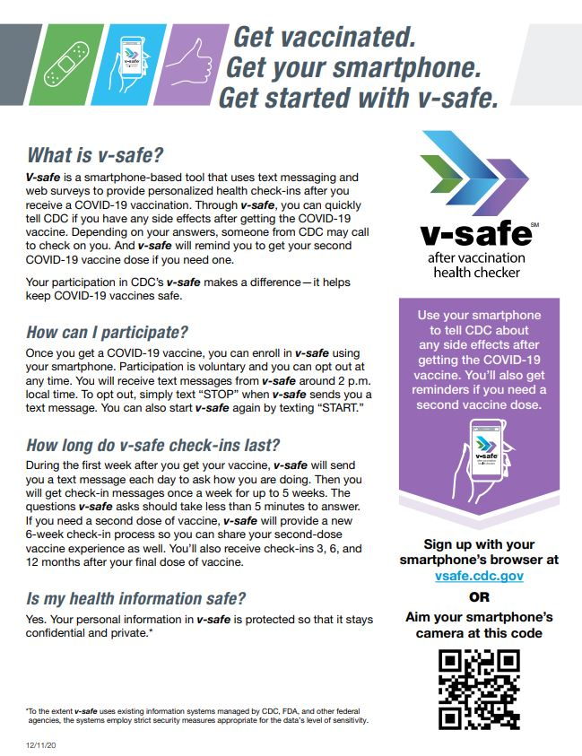

Slide 45
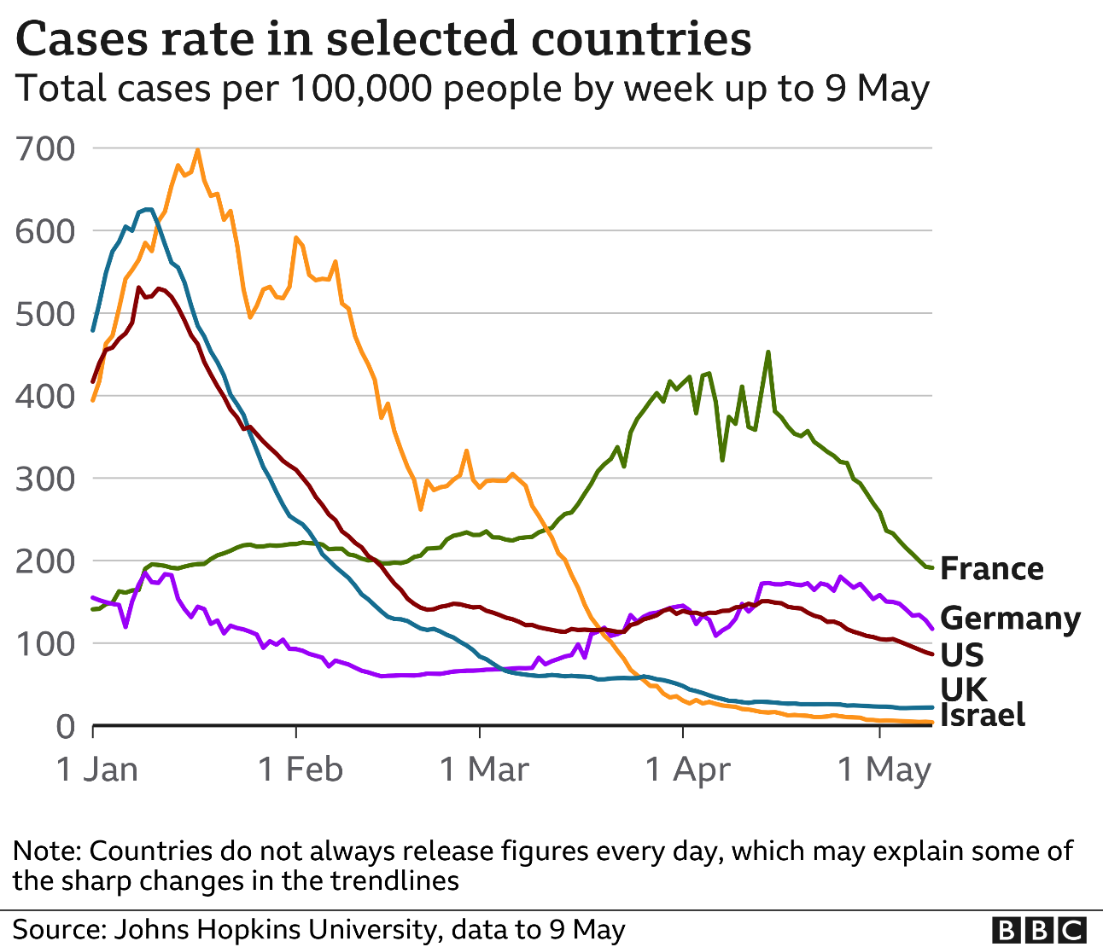
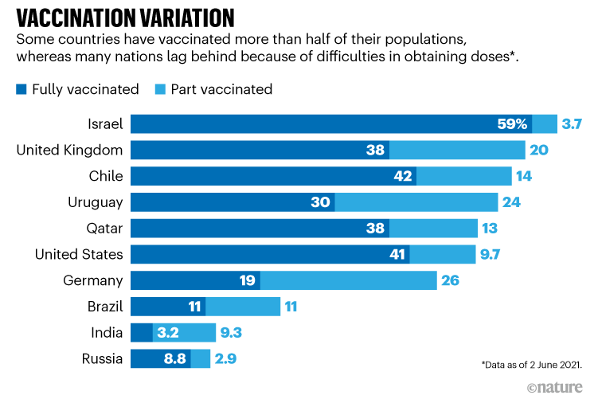
Question 5
Real World Effectiveness
Notes:
5. Dr. Sullivan, the COVID vaccines were brought to market in record time and only enjoy emergency use authorizations. What assurances do we have that they are safe and effective?
Discussion:
Real world effectiveness can be measured by watching countries such as Israel and UK with high vaccine rates and you can watch their COVID cases decrease overtime
Countries= https://www.nature.com/articles/d41586-021-01505-x

Slide 46
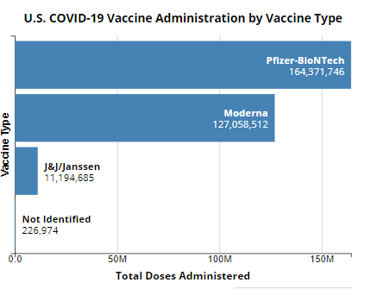
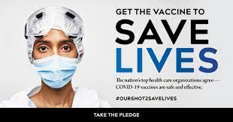
Safe. Effective. Save Lives
https://covid.cdc.gov/covid-data-tracker/#vaccinations

Slide 47
How do we address the challenge of quickly vaccinating most, if not all, of our population while ensuring equitable access and reach?
A focus on equitable distribution of the vaccine must be at the core of every vaccine response plan

Slide 48
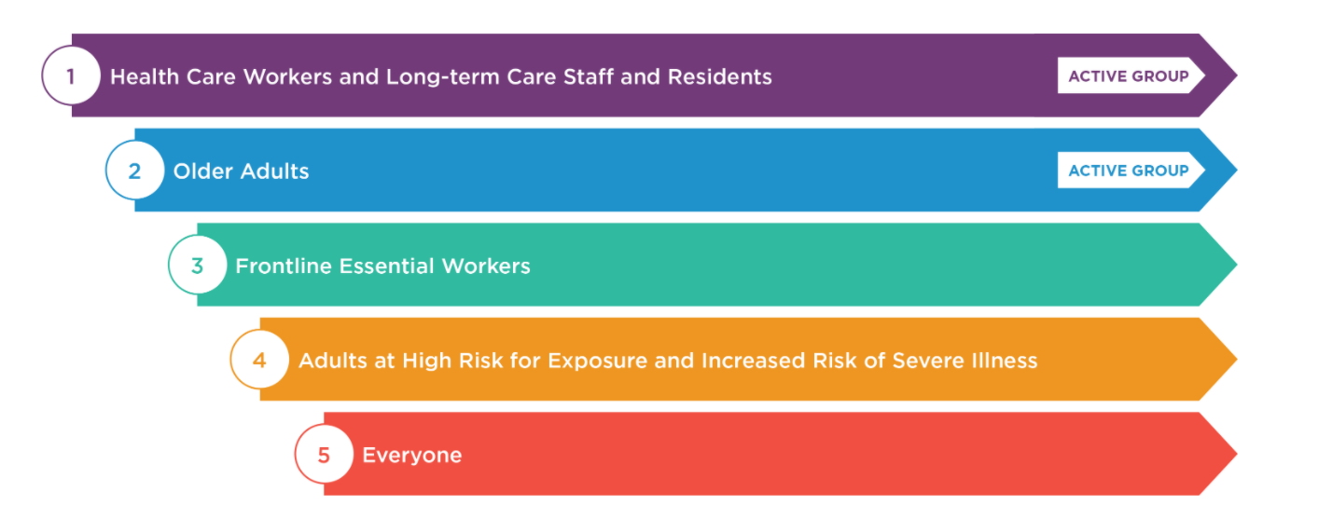
COVID-19 Vaccine & Mecklenburg County
February, 2021

Slide 49
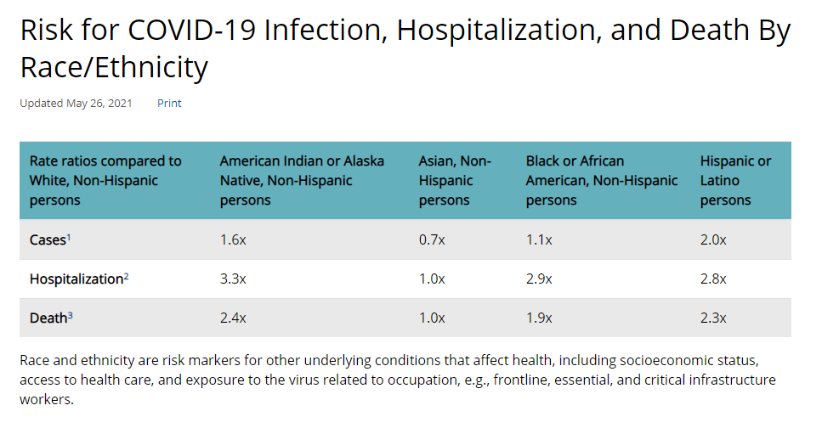
Question 6
Disproportionate Impact of COVID-19
https://www.cdc.gov/coronavirus/2019-ncov/covid-data/investigations-discovery/hospitalization-death-by-race-ethnicity.html

Slide 50
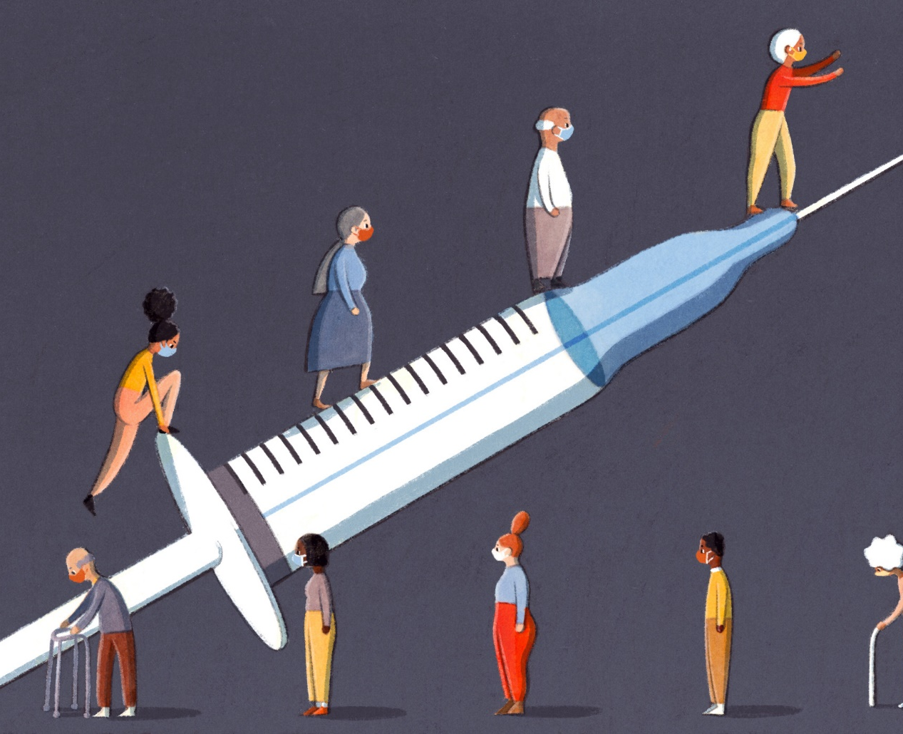
Equitable Access to Vaccine

Slide 51
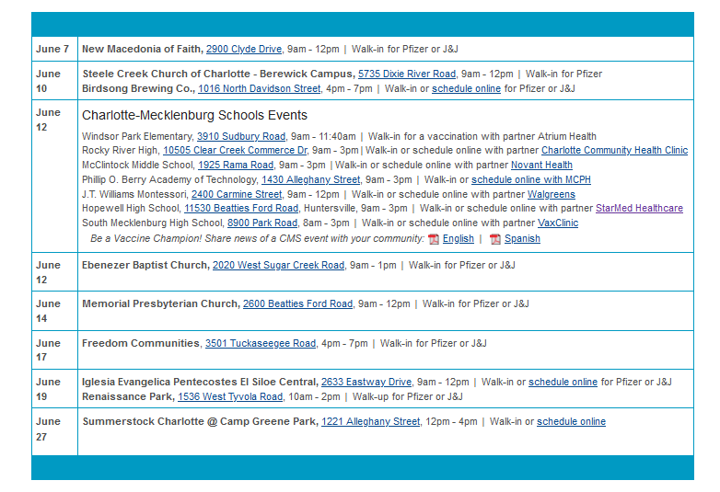
Question 6
MCPH Vaccine Equity Plan

Slide 52
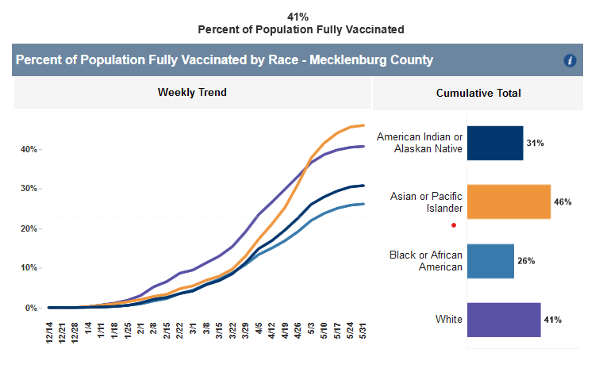
County Level Data for Race/Ethnicity
Notes:
7. Dr. Sullivan, can you explain how data and analytics are being used to monitor the pandemic, identify inequities, and target response?
{comments or graphics?}
COUNTY APPROACH TO USING DATA FOR RACIAL/ETHNIC EQUITY
Discussion points:
Data has been used continuously during this population nationally but also locally. We use data provided by the state such as the graphic on the left to identify gaps in vaccination distribution by race, ethnicity, gender, and age. We also track the health department individually to check our personal reach. We also can use data to see where in our county are there are decreased vaccine rates. We use these data sources, and more, to change our vaccination strategy through changing our messaging/education, reaching out to different providers to partner with, or hosting events within these communities.
Reference:
Race line graph=DHHS vaccination
Race over time= MCPH
Rates over 12= MCPH

Slide 53
Percent of Residents At Least Partially Vaccinated, Mecklenburg (based on all Vaccination Programs administering doses to Mecklenburg Residents)
45.3%
Percent of all Residents Partially Vaccinated
Race/Ethnicity
Gender
Age
Source: NC DHHS COVID19 Dashboard https://covid19.ncdhhs.gov/dashboard/vaccinations
Data as of May 28, 2021

Slide 54
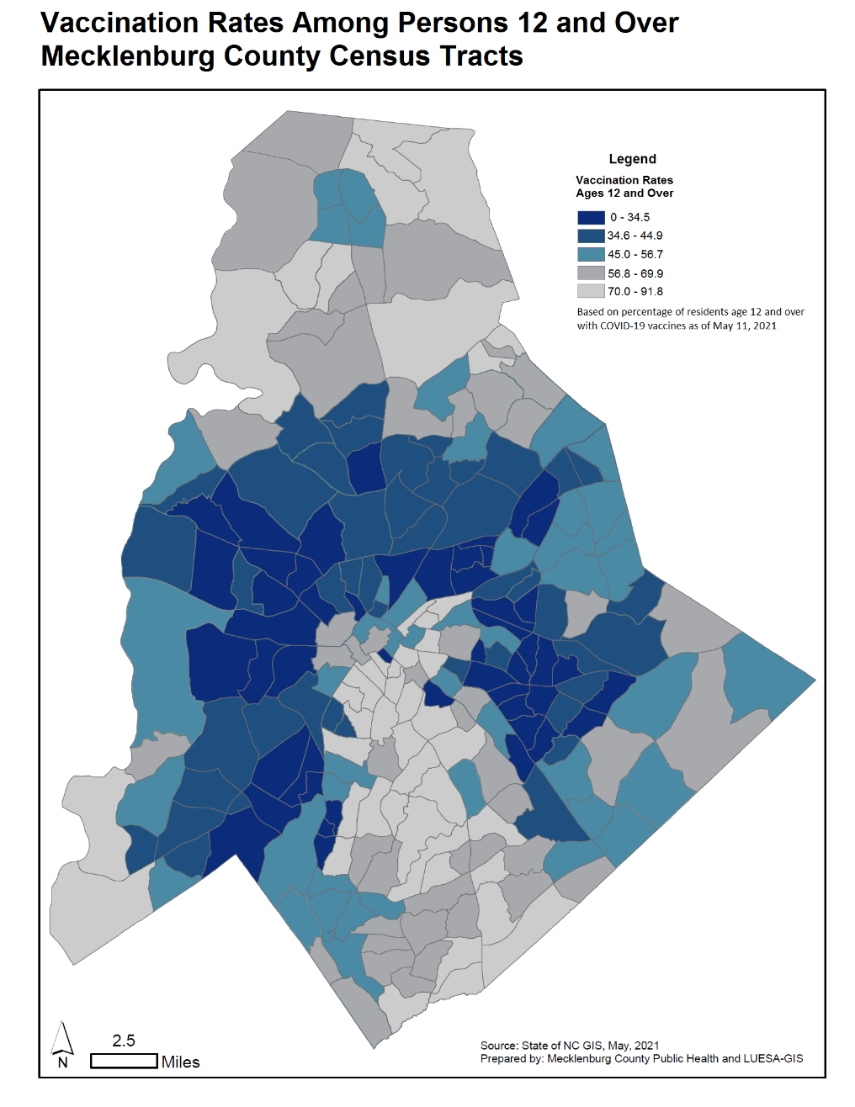
County Level Data for Geographic Vaccine Uptake
Graphic found through Johns Hopkins Coronavirus Resource Center

Slide 55
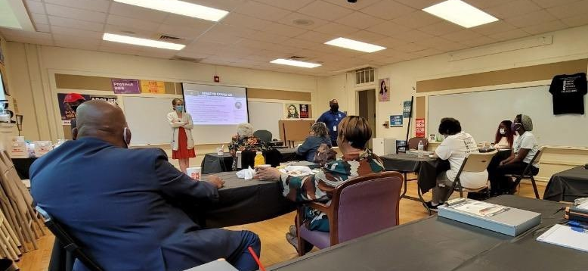
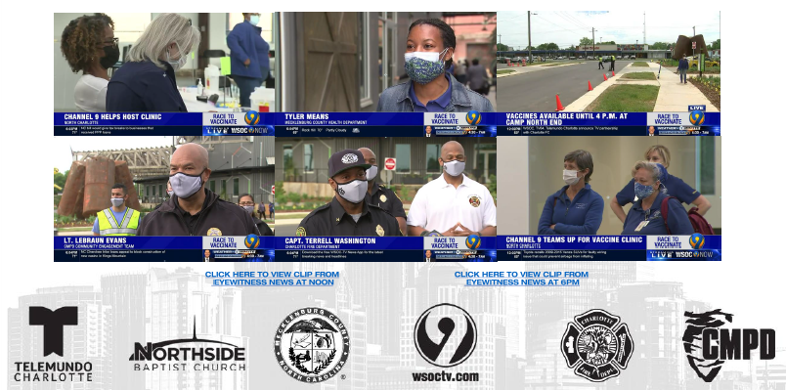
MCPH COVID-19 Vaccine Update
Public Health efforts are focused on reaching the hardest to reach individuals and those not actively looking for a vaccine:
Partnering with existing community events and venues to offer pop-up clinics where people are:
Black Food Truck Friday Event (5/7)
Catawba Brewing (5/7)
Camp North End (5/8)
Simmons – YMCA (5/10)
Continuing vaccinations for homebound residents and their families.
Launched canvassing campaign with Action NC this week.
Continuing mass media campaign with equity focus.

Slide 56
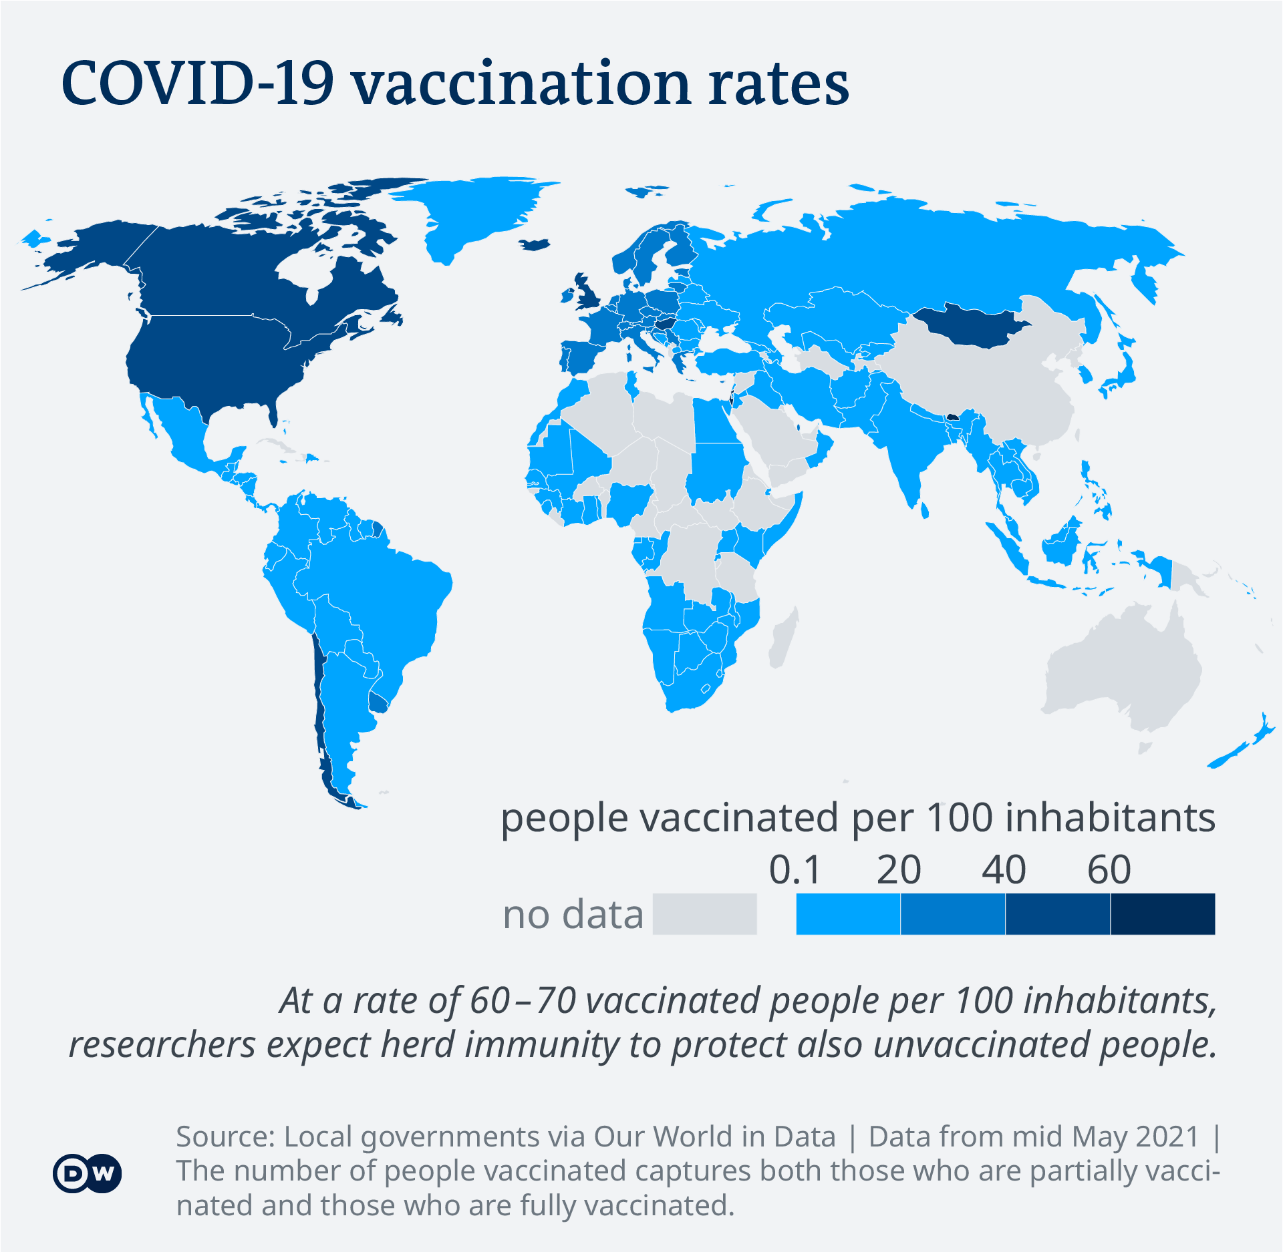
Global Uptake of Vaccine
Notes:
6. Dr. Sullivan, COVID requires that we quickly vaccinate our entire population. What challenges does that bring and how do we ensure equitable access and reach? (both domestically and globally?)
{several slides/graphics?}
Discussion could include:
Reference:
Map=https://www.dw.com/en/covid-19-vaccinations-whats-the-progress/a-55648707

Slide 57
Global Initiatives for Equitable Access
Notes:
6. Dr. Sullivan, COVID requires that we quickly vaccinate our entire population. What challenges does that bring and how do we ensure equitable access and reach? (both domestically and globally?)
{several slides/graphics?}
Discussion could include:
Globally the Kaiser family foundation has laid on the US’ 4 main strategy plans which include increasing donations to other countries, providing funds, expanding manufacturing, and releasing the vaccine patent.
Reference:
KFF=https://www.kff.org/global-health-policy/issue-brief/global-covid-19-vaccine-equity-u-s-policy-options-and-actions-to-date/

Slide 58
Parting Thoughts
Overcoming our human frailties is challenging on a daily basis, even more so during a pandemic.
Fear and selfishness counter our better angels, even when we know those actions ultimately harm our own best interests.
Stress lays bare the biases and prejudices we pretend we don’t have.
Social Darwinism is always lurking (and baked into the status quo).
We have to constantly and continuously choose Stone Soup over Lord of the Flies.

Slide 59
VACCINES – HOW THEY WORK AND WHY YOU SHOULD GET ONE
Meg Sullivan, MD, MPH
Medical Director
Mecklenburg County Public Health
Patrick Robinson, MD, MPH
former CDC EIS Officer
APHI Research Professor, UNC Charlotte
Thank you for joining us!
Be sure to complete the brief Qualtrics survey (link posted in the chat)

