Slide 1


Community Violence Prevention
Mecklenburg County Office of Violence Prevention
Presented by:
Tracie Campbell, MS, CHES
Senior Health Manager

Slide 2
OVP Mission
To reduce violence in Mecklenburg County by collaborating with County, City, Partners, and Community to increase opportunity, and build healthier, more resilient communities.
Vision
All residents of Mecklenburg County will live, learn, work, and play in safe, healthy, thriving communities.

Slide 3
Violence increased over the last several years in our community, including gun-related homicides and assaults which are on track to exceed last year’s
19%
Source: Charlotte-Mecklenburg Police Department Crime Stats

Slide 4
Framework to Address Violence
Intergovernmental Collaboration
Community Engagement & Mobility
Generate Data and Evidence
Invest in Community-Led Prevention Initiatives
Interrupt Violence
Co-funded and programmatic partnership for Violence Interrupter Program
Joint monthly meetings
Violence Prevention Comprehensive Plan
Peacekeepers Academy
100 Youth Advisory Council
OVP Connecting Communities Learning Series
Co-lead multiorganization Violence Prevention Data Collaborative
Foster development of sound infrastructure and capacity building via Peacekeepers Academy
Introduce Violence Prevention evidence-based, best practice strategies used throughout the country
County /City partnership Selected Violence interrupter Host organization
Support all other efforts to interrupt violence within Mecklenburg County
POLICY PRACTICE PROGRAMS

Slide 5





Violence as a Public Health Issue
Define and monitor the problem
Identify risk and protective factors
Develop and test prevention strategies
Assure widespread adoption of effective prevention programs

Slide 6

Multi- Level Prevention
Tertiary
Secondary
Primary

Slide 7
Comprehensive Plan
1. Collaboration
2. Inclusion
5 Guiding Principles
3. Capacity-Building
4. Accountability
5. Access & Equity

Slide 8

Interactive learning series designed to assist grass roots community-based organizations (CBO’s) to develop sound infrastructure and to increase capacity building.
Coming Fall 2021

Slide 9

100 YOUTH ADVISORY COUNCIL
GOAL
ACTIVITIES
To increase youth engagement in identifying solutions to prevent youth violence and increase neighborhood safety
Advise OVP– look at specific programs in Mecklenburg and identify gaps and where/what new opportunities need to be introduced
Participate in conversations around neighborhood safety and improvements
Present recommendations elected officials and community stakeholders
Inform about youth violence prevention initiatives
Facilitate conversations around youth violence prevention
PARTICIPANTS
Middle & High School Students
18–24-year-olds

Slide 10
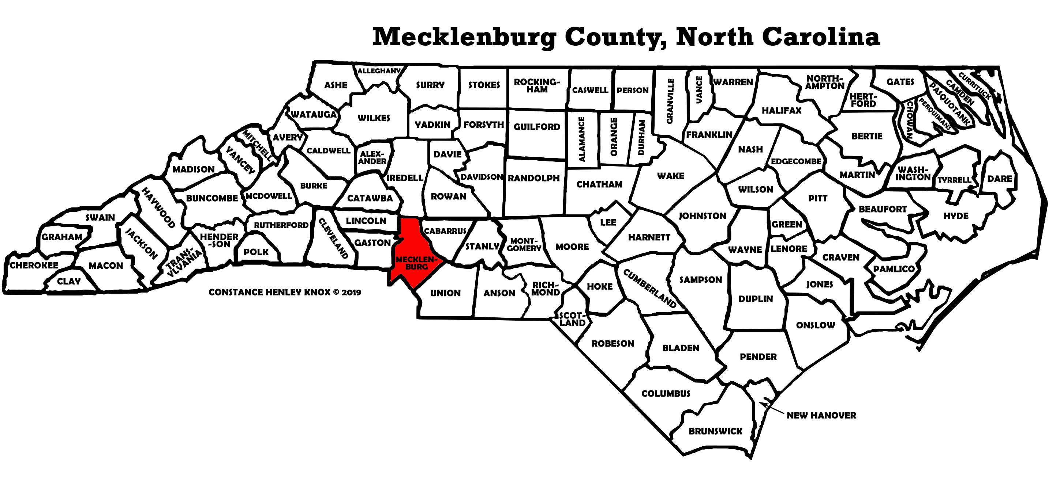
Regional Violence Prevention Coalition

Slide 11

Violence Interruption Program
Alternatives to Violence
  Cure Violence Global (CVG) employs an evidence-based methodology to reduce violent crime and violent incidents
    Leverage trusted messengers from the community to interrupt and prevent violence
  County and City partnered with CVG to implement Violence Interrupter Model - Beatties Ford Road/LaSalle St, Corridor
    Identified as one of four durable violent crime areas in Charlotte
  CVG will provide technical assistance to Youth Advocate Programs in first year of implementation

Slide 12

Hospital-Based Violence Interruption Program
Atrium Health
Identify victims of violence at the hospital
High risk for sequent violent re-injury or retaliation
Provide wrap-around services
Goal of reducing the likelihood of their future involvement in violence, either a victim or as a perpetrator
Anticipated Launch November 2021

Slide 13








Violence Prevention Data Collaborative
Work team of the Violence Prevention Plan
Charged with data sharing, analysis, reporting and evaluation, e.g.:
  Community Violence Data Dashboard
  Analysis of data integrated across systems
  Aligned program evaluation, including Cure Violence and HAVI
Notes:
Development of and reporting on shared indicators;
Facilitating data sharing to support implementation of violence prevention programs, particularly in Community Collaborative Areas;
Analysis and interpretation of available data (either within Partner systems or integrated at individual-level across systems) to inform program design, monitor program implementation, and evaluate program impact, along with best practice recommendations;
Development and implementation of evaluation plans for newly implemented programs, including a comprehensive, aligned strategy between the new community-level and hospital-based violence prevention programs.

Slide 14
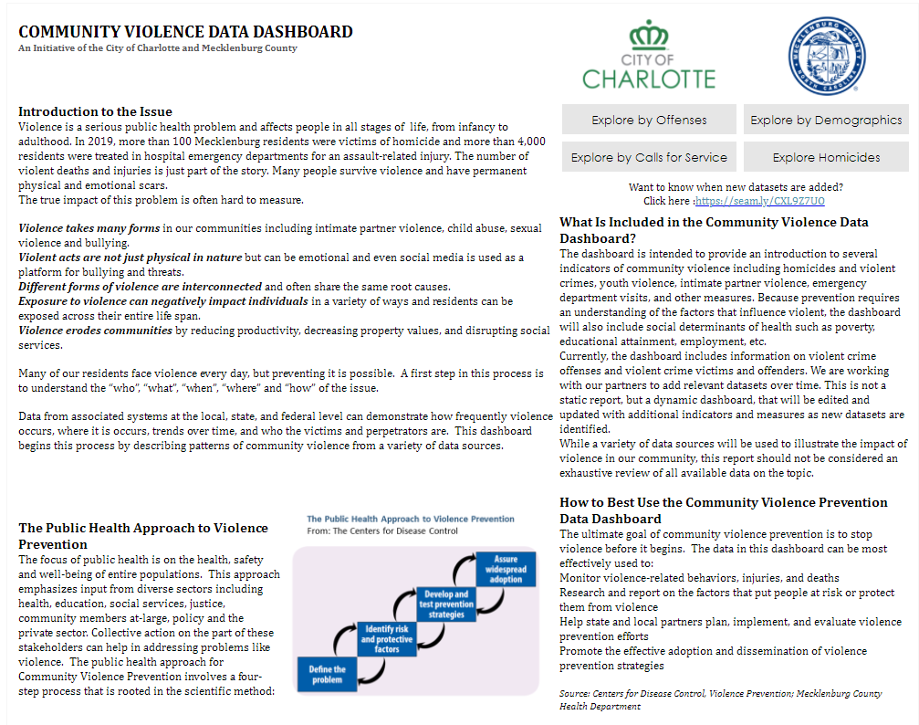
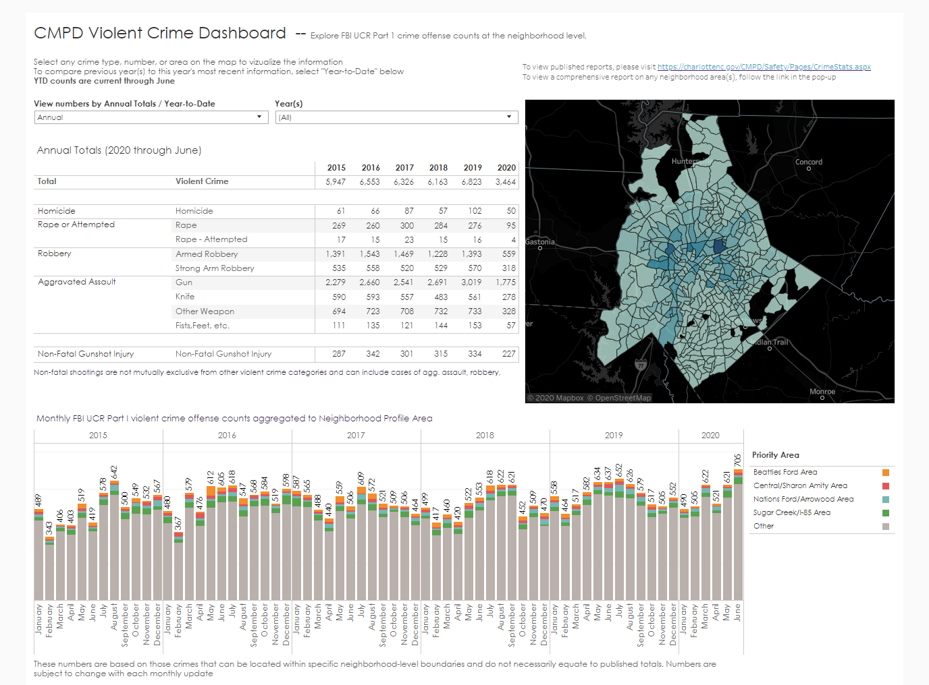
Community Violence Data Dashboard
Accessible at: https://public.tableau.com/views/CommunityViolenceDataDashboard/HomePage

Slide 16
WHAT’S NEXT?
The Commitment
OVP
Community
Support Efforts
Spotlight Organizations
Listen to Feedback /Input
Develop Partnerships
Foster Collaboration
Assist Capacity Building & Infrastructure
Introduce New Opportunities
Take Action
Facilitate Change
Be Open Minded
Share Community Needs
Willingness to Collaborate
Shift towards IMPACTFUL CHANGE
Initiate tough conversations among diverse groups
Partner with OVP

Slide 17

Questions

Slide 18
Contact Information
Tracie.Campbell@mecklenburgcountync.gov
980-314-9117 (o)
980-2889035 (c)

