Slide 1
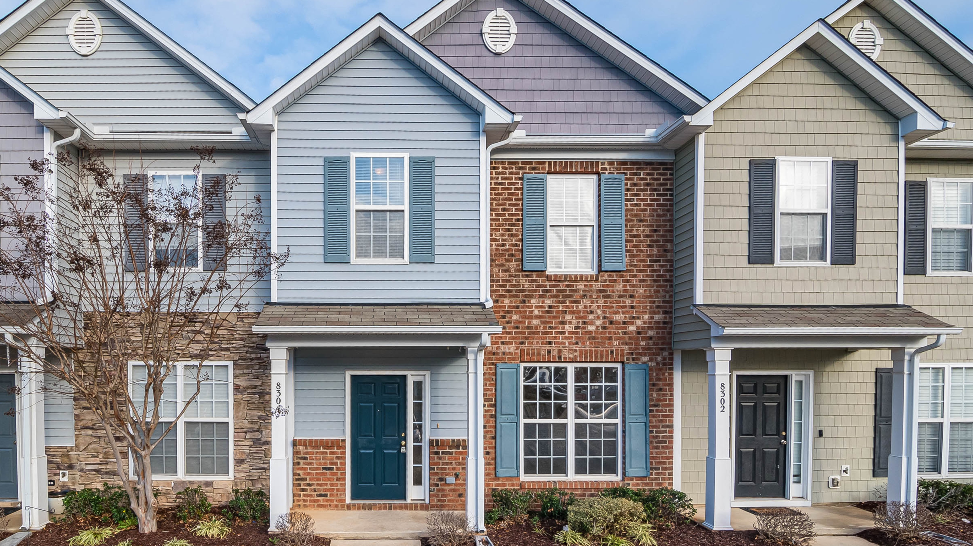
The Traits of Thriving Neighborhoods
Moving the needle on economic mobility starts with understanding the factors that determine outcomes.
APHI Nexus
April 9, 2021
Notes:
Greetings
Thanks for including us
Why it’s a natural fit for us to enter the conversation on SDH… and link to previous speaker
Moving the needle on economic mobility starts with understanding the factors that determine outcomes. In this presentation, I will
-- explore data on economic mobility by neighborhood
-- discuss which factors best explain the geographic variation we observe
-- and then use those factors as a framework to identify where action is most needed.
Let’s dive in //>

Slide 2

Community-level descriptive statistics can be powerful but can also be deceiving.
Notes:
The folks on my team know that one of the fastest ways to get me up on a soapbox is to use a community level indicator-- metro and county and even city level descriptive stats can be powerful but they can also be really deceiving. Now I know that sometimes these data are the best we have, and in that case let’s make the most of them– but I certainly won’t be the first or last person to say that if we’re really going to move from data to action we NEED to help folks with power over resources understand that disaggregation is worth the price tag. Of course, we need to disaggregate in a number of ways, but particularly when we talk about economic mobility, I want to argue in favor of breaking down what we know about our city by neighborhood. Take for example the stat you see here. About one of every two third graders in CMS is proficient in English and math. Since we know that third grade test scores are a strong predictor of future economic mobility, we might be tempted to design some sort of large-scale education intervention to close the gap: I imagine it could have some snappy tagline about “the student sitting in the next desk” //>
___
I want to start by arguing that neighborhoods really are the best unit of analysis for this type of work
We all know that outcomes vary across the city but often we rely on community level – descriptive statistics as our indicators… these can be very deceiving.
Let’s take 3rd grade test proficiency as an example. If we look at county level data we see that about 1 in 2 students in proficient…
Someone looking might fairly conclude that if you went into any CMS elementary school classroom about half the student would be proficient
//
Use the 3rd grad reading map…
Scores are strong predictors but not everyone is in the middle…

Slide 3
In this case, test proficiency is 70-100% in the wedge and 3-40% in the crescent, so a county-level stat is not useful in the wedge or the crescent.
Notes:
But it turns out that, while 1 in 2 might be true in a technical sense, it won’t be surprising to any of y’all that it’s not true in a practical sense. When we look at 3rd grade proficiency on a neighborhood level, we see that outcomes follow a familiar geographic pattern. Nearly every student in the wedge scores “proficient” on their EOG while than 1 in 10 students in the crescent achieve the same score. When we look at this 50% number, we’re really just averaging the outcomes of two very different experiences. You might be asking if this pattern holds true for other social determinants– is this just a rich schools vs poor schools thing or are neighborhoods actually significant drivers of variation in economic mobility outcomes?
___
To know more about those student’s experiences, and how folks like us might close this achievement gap, we need to decide how much we need to “zoom in” to the data.

Slide 4
Neighborhoods and school catchment areas explain over half of all variation in economic mobility
100
Tract
80
60
High school catchment area
Percentage of variance accounted for by geography
County
40
20
Commuting zone
0
All Races
White
Black
Hispanic
Adapted from Chetty’s Opportunity Atlas slides
Notes:
The folks up at Opportunity Insights have tracked how much of the variation in economic mobility overall is explained by conditions at different different geographic levels… as you can see here, census tract and high school catchment areas explain more than half of this variation, and for black folks high school and neighborhood explain almost 2/3 of the variation. As we expected from our third grade reading example, county-level isn’t very explanatory at all. What this tells us is that, if we are going to take action on economic mobility our work needs to be place-based. But how specific do we need to focus?

Slide 5
We need to focus on neighborhoods
Impact of poverty rate on child household income by distance in blocks (left) and tracts (right)
0.00
0.0
-0.02
-0.1
Since (e.g.) poverty rates in neighboring tracts have little predictive power conditional on poverty rate in own tract… it seems tracts are sufficiently precise
Size of correlation
Size of correlation
-0.04
-0.2
1 mile from origin
-0.3
1 mile from origin
-0.06
0
20
40
60
80
100
120
140
160
180
200
0
1
2
3
4
5
6
7
8
9
10
Number of blocks away from origin
Number of census tracts away from origin
Adapted from Chetty’s Opportunity Atlas slides
Notes:
Well, we can get a clue by comparing data on the impact of poverty rates on child household income by distance at the block and tract level. From the chart on the left we can see conditions in the half mile radius around a child’s home are strong predictors of their economic mobility… and from the chart on the right, that although census tracts are bit larger, that they are still good proxies for neighborhoods. This tells us that if we want to understand what to do about economic mobility we need to understand it at neighborhood level. // >
___
We see some neighborhoods are good + some don’t produce strong outcomes
So what’s the right geographic area?
Bar chart… neighborhoods
Show block plot… about .5 miles from home

Slide 6
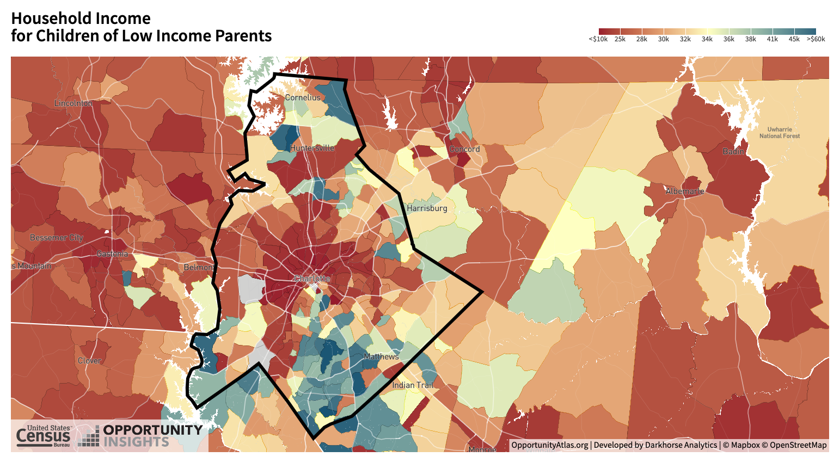
We know neighborhood-level variation in economic mobility outcomes from Chetty’s data.
Why does this variation exist?
i.e., is there something fundamentally different about the people in different colored tracts (selection) or are these outcomes the product of neighborhood conditions (causal effects of place).
5
Notes:
And that’s exactly what the Opportunity Atlas set out to do: map mobility. Charlotte may be 50 out of 50 but some of it’s neighborhoods are opportunity engines while others are opportunity deserts. On the other hand, Salt Lake City which is #1 in mobility is almost all blue. What we need to ask next is why does this variation exist? Is there something fundamentally different about the people in different colored tracts (we can say, is this a matter of selection) or are these outcomes the product of neighborhood conditions (aka the causal effects of place)?
___
So we’d want to examine differences between conditions at a tract-level. We can start by
(a) begin with the OI atlas map of Mecklenburg county. Extract tracts where outcomes for children of low income parents were either (i) below the national average for everyone [44k] or (ii) below an average of similar outcomes for low income individuals in peer cities [34k] (remember from jan: our peers are Raleigh Austin Columbus Denver Nashville
Atlanta Minneapolis Portland)

Slide 7
To answer this question Chetty and his colleagues examined a nearly 30-year-old experiment called Moving to Opportunity
4,600 families at 5 sites from 1994-98: Baltimore, Boston, Chicago, LA, New York.
Families randomly assigned to one of three groups:
  Control: public housing in high-poverty (50% at baseline) areas.
  Section 8: conventional housing vouchers, no restrictions.
  Experimental: housing vouchers restricted to low-poverty (<10%) Census tracts.
Chetty, Hendren, and Katz (2016) show that children who moved using vouchers when young (<age 13) earn more; those who move at older ages do not.
  This indicates that given otherwise similar family environment, place-based effects determine outcomes
Adapted from Chetty’s Moving to Opportunity slides
Notes:
To answer this question, we need to go back 30 years to a HUD experiment that was hailed at the time as, well, a failure. The experiment was run with 4600 families cross five cities in the mid-90s. The experiment set out to discover: what would happen if families living in high poverty areas moved to low poverty areas? Post-mortems in the late 90s and early 2000s found that “moving to opportunity” didn’t really improve outcomes for participants; however, Chetty and his colleagues showed in a 2016 paper that while outcomes for parents and older children didn’t change much, that economic mobility increased for children in the experimental group who moved before age 13. What this tells us is that given otherwise similar family environment, place-based effects have a strong influence on outcomes. Let’s look at the outcomes for a set of sites //>

Slide 8
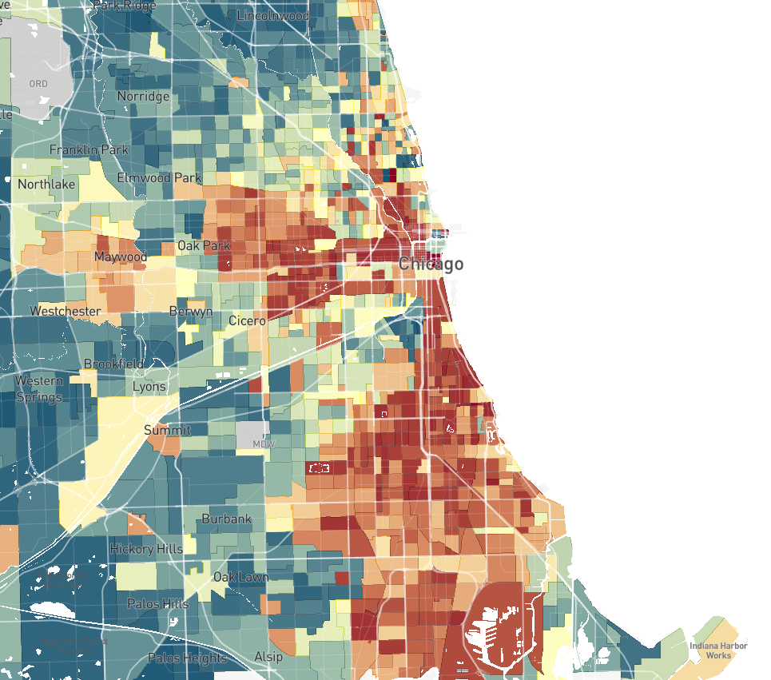
Moving To Opportunity Experiment: Origin (Control Group) Locations in Chicago
= Control
= Section 8
= Experimental
Ida B. Wells Homes
Stateway Gardens
Robert Taylor Homes
Notes:
Participants in the Chicago study were residents of three public housing developments on Chicago’s south side. These families were randomly assigned to one of three groups: folks who got housing vouchers only valid in lower-poverty census tracts (diamonds), folks who got housing vouchers without restrictions (triangles), and folks who didn’t get housing vouchers (circles). //>

Slide 9
Moving To Opportunity Experiment: Origin and Destination Locations in Chicago
= Control
= Section 8
= Experimental
Oakland
Washington Park
Grand Crossing
Calumet Heights
Cottage Grove Heights
Riverdale
Notes:
We can see here where folks with the vouchers moved. I used to live right in between where it says Washington Park and Grand Crossing, but even if you don’t know anything about Chicago’s neighborhoods its clear from the distribution of destinations here that there’s a pattern. //>

Slide 10
Earnings of Young Children in MTO Experiment vs. Observational Predictions from
Opportunity Atlas
$11,000
Mean Indiv. Earnings in MTO (with site FE)
$8,000
= Control
= Section 8
= Experimental
$5,000
$7,000
$9,000
$11,000
$13,000
Mean Indiv. Earnings for Children with Parents at p=10 in Opportunity Atlas (with site FE)
Chicago
Chetty, Hendren, and Katz (2016, Online Appendix Table 7, Panel B)
Notes:
When we compare average outcomes for children in each of these families with average outcomes for families in each neighborhood in the Opportunity Atlas we see this pattern even more clearly: when kids move to higher opportunity neighborhoods they are more economically mobile themselves. //>

Slide 11
Earnings of Young Children in MTO Experiment vs. Observational Predictions from
Opportunity Atlas
$11,000
Correlation = 0.60
Slope = 0.71
(0.26)
Mean Indiv. Earnings in MTO (with site FE)
$8,000
= Control
= Section 8
= Experimental
$5,000
$7,000
$9,000
$11,000
$13,000
Mean Indiv. Earnings for Children with Parents at p=10 in Opportunity Atlas (with site FE)
Baltimore
Boston
Chicago
LA
NY
Chetty, Hendren, and Katz (2016, Online Appendix Table 7, Panel B)
Notes:
This trend wasn’t just a quirk of the experiment in Chicago, when the analysis was repeated, it persisted in each of the other MTO cities. From these data we can see that variation in economic mobility seems to be driven more by the causal effects of place rather than selection. //>

Slide 12
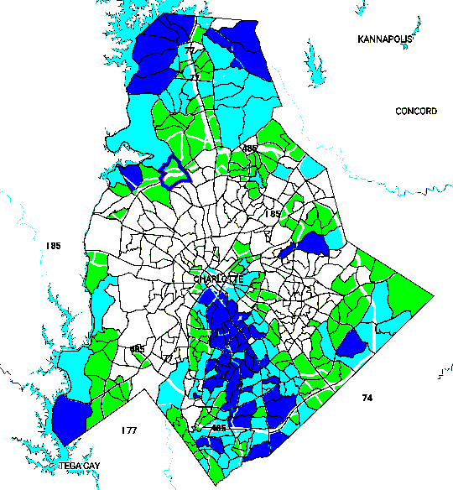
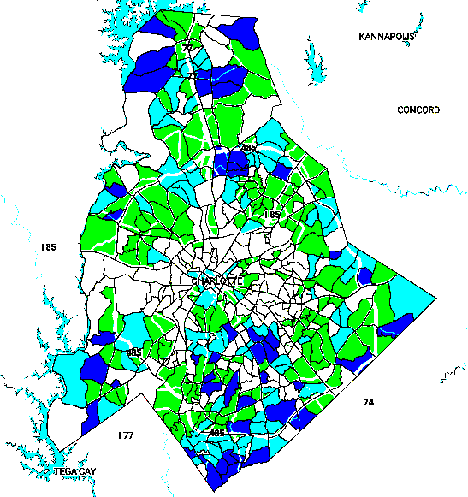
What are the traits of thriving neighborhoods?
Notes:
As soon as we accept that causal effects of place drive variation more than selection, we want to know: what are the traits of thriving neighborhoods? What are the most important factors that make some of the neighborhoods on this map light up blue others light up red? //>

Slide 13
Neighborhood traits are strong predictors of economic mobility
Chetty’s team identifies four key predictors:
  Lower poverty rates
  Stable families
  Greater social capital
  Better quality schools
Leading on Opportunity adapted these in the task force report for Charlotte:
  The Impact of Segregation
  Child & Family Stability
  Early Care & Education
  College & Career Readiness
  Social Capital
Notes:
Chetty identifies four traits: lower poverty rates, stable families (two parent families), greater rates of social capital, and better quality schools. In the task force report Leading on Opportunity contextualized these factors into five determinant areas most relevant for Charlotte: segregation, child and family stability, early care and education, college and career readiness, and social capital. But these predictors are quite broad… what specifically could we measure in every neighborhood around charlotte that would clue us into how economic mobility is changing as our community works to tackle this issue? //>

Slide 14
Diving deeper we can see that some factors are more predictive than others
Number of Jobs Within 5 Miles
We can use these correlations to challenge what we think to be true about economic mobility. For instance:
A. Proximity to proximity to people who have jobs matters 4x more than proximity to newly available jobs.
B. Test scores (also slides 4-5) matter much less than simply being zoned for a quality school (see previous slide).
C. Family structure still matters a lot.
The factors here explain half of the tract level variation (Σ R² = 0.504).
High-Paying Jobs Within 5 Miles
Job Growth 2004-2013
A
2000 Employment Rate
Share Above Poverty Line
B
Mean Household Income
Mean 3rd Grade Math Score
Share College Grad.
Share Single Parent Households
C
Census Return Rate
Share Black
Share Hispanic
Population Density
0
0.2
0.4
0.6
0.8
Positive
Negative
Magnitude of correlation (controlling for race)
Opportunity Insights
Notes:
We can look more closely at what factors are most indicative of mobility. We can use these correlations to challenge what we think to be true about economic mobility and then to target out action accordingly … for instance in box A we see that proximity to jobs doesn’t seem to matter nearly as much as proximity to people who have jobs, similarly, while 3rd grade test proficiency is still predictive, if we think back to the slide where we examined the share of variation by school catchment zone we can imagine that attending a higher quality school may actually matter more in the long run than how well a child performs on one particular test. //>
___
Here I’ve highlighted three interesting correlations. First let’s look at box A: here we see that employment rate is significantly more correlated with mobility than job growth. This is really interesting because for a long time we thought that improving access to jobs would improve economic mobility, I remember in my urban sociology classes back in undergrad talking about “spatial mismatch” – the idea that it’s really important that new jobs be near people who need them – and this is still important, just not as important for children as having a job: it seems that the driver for economic mobility is not number of jobs available but number of people you know with jobs. In box B we see something similar going on: third grade test scores are still predictive of outcomes, but so is school quality: if we think back to the slide where we examined the share of variation by school catchment zone we can imagine that attending a higher quality school matters more in the long run than how well you do on one particular test. Finally in box C: we see that family structure still matters a lot. If we think about this on a neighborhood scale its less about individual households led by a single parent and more about creating neighborhoods where kids are surrounded by two-parent families.
___
We can use these correlations to challenge what we think to be true about economic mobility … for instance proximity to jobs doesn’t seem to matter much, but proximity to people who have jobs does
third grade math score doesn’t seem to matter much, but high school catchment area (school quality) is very explanatory
using these correlations we can build a predictive model for mobility

Slide 15
Examining work by Chetty and others we can compile a list of semi-predictive neighborhood characteristics:
This evidence supports and nuances the initial opportunity task force recommendations
(1) Family Structure
  Share single parent households (%)
  ACS/OI Atlas
(2) Educational Attainment
  Share of college grads (%)
  Source: QOL/ACS
(3) Educational Access
  Share of students attending neighborhood school by quality
  Source: NCSBE, QOL (Approx.), CMS (More accurate)
(4) Family Stability
Share of residents below the poverty line
  ACS/QOL
(5) Economic Access
  Commute time
  QOL/City
(6) Economic Attainment
  Share employed (%)
  ACS/QOL (Approx.), State Unemployment (Better)
(7) Segregation
  (a) income (b) race
  Theil Index, Dissimilarity
  ACS/Census/QOL
(8) Inequality
  Gini for MSA/CZ by race
  ACS/Census
(9) Social Capital (2 ways)
  Chetty: Common proxies
  LOO: Targeted area for future work
  QOL, neighborhood orgs
Notes:
If we look at this deeper level at the evidence from Chetty and others we can compile a list of neighborhood characteristics that explain half or more of the variation from one neighborhood to the next:
share of single parent households – Atlas/ACS
- share of college graduates – QOL/ACS
- zoned for quality neighborhood school – approximate or via CMS?
- segregation by income* - ACS
- segregation by race - ACS
- employment rates – approximate by ACS in QOL
- share of residents below the poverty line – ACS/QOL
- income inequality (community wide measure) – Gini
- transit access – QOL/City
- social capital
By focusing our measurement on these things, and comparing these indicators with the opportunity atlas as our counterfactual, we can create something of an opportunity index that tracks our progress and points us toward the kind of interventions that might move the needle on mobility //>
___
We can use the data from MTO90 to determine more precisely what place based aspects are most important…
Examining work by Chetty and others we can assemble a list of semi-predictive neighborhood characteristics worth measuring:
- share of single parent households – Atlas/ACS
- share of college graduates – QOL/ACS
- zoned for quality neighborhood school – approximate or via CMS?
- segregation by income* - ACS
- segregation by race - ACS
- employment rates – approximate by ACS in QOL
- share of residents below the poverty line – ACS/QOL
- income inequality (community wide measure) – Gini
- transit access – QOL/City
- social capital
Between the ACS, QOL, Opportunity Atlas public data, and state board of education we can compile information on all but social capital
Chetty and team use three measures to approximate this: census return rate, religiosity, and violent crime.
We can start with these commonly used measures
+ we can begin building a local social capital index by Census Tract using an adapted version of a tool by Rupasingha, Goetz, & Freshwater
Social capital is a tricky measure…
2 approaches: what we can measure → the way chetty measured it
what we can’t measure: the way the TF report constructs it
what we will do about this?
Their model is designed for use on a county level and measures the following things:
- Number of establishments in Religious organizations → religious orgs within x distance (e.g. .5 miles)
- Number of establishments in Civic and social associations →
- Number of establishments in Business associations → plot businesses registered with county
- Number of establishments in Political organizations → ?
- Number of establishments in Professional organizations → ?
- Number of establishments in Labor organization → ?
- Number of establishments in Bowling center → bowling within 5 miles
- Number of establishments in Recreational Centers → counts and/or ymca memberships by tract
- Number of establishments in Golf and Country Clubs → within x miles
- Number of establishments in Sports Teams and Clubs → ?
- Population –> Density
- The aggregate for all of above variables divided by population per 1,000 (1st factor)
- Voter turnout (2nd factor) → voter turnout
- Census response rate (3rd factor) → response rate 2020
- Number of local-serving QOL neighborhood organizations dataNPOs (4th factor) --> ?

Slide 16
Knowing is not enough, we must act
These data point us in to three types of interventions:
We can enable people to move to higher opportunity neighborhoods
We can invest in neighborhoods to increase opportunity outcomes
We can reduce ”stickiness” in intergenerational mobility by expanding access to postsecondary pathways
Notes:
We’re just beginning to dive into what this might look like, but in keeping with the theme of today knowing what makes a thriving neighborhood isn’t enough, we need to move from data to action. We can do that in three ways:
We can enable people to move to higher opportunity neighborhoods
We can invest in neighborhoods to increase opportunity outcomes
We can reduce ”stickiness” in intergenerational mobility by expanding access to postsecondary pathways
I’ll close by walking through each in turn.//>

Slide 17
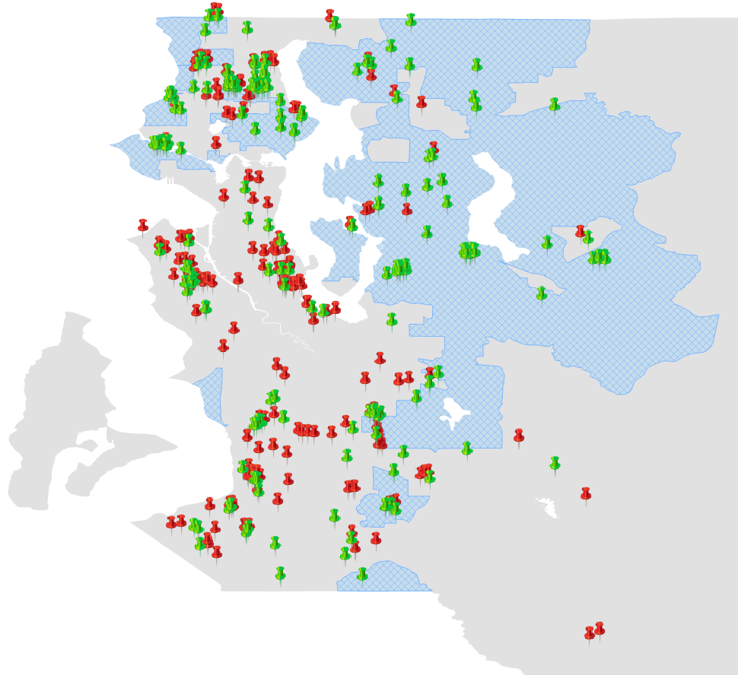


We can enable people to move to higher opportunity neighborhoods
Not just affordable housing, but specifically affordable housing in high opportunity neighborhoods
  LOO is supporting Inlivian to join a HUD sponsored national-scale trial modeled after the Creating Moves to Opportunity experiment in Seattle (image on left)
  2040 plan offers tools to expand access to lower-cost housing in higher opportunity neighborhoods
Lake City
Inglewood
Magnolia
Northeast Seattle
Bellevue
West Seattle
Newport
Cougar
Mountain
Issaquah
Rainier
Valley
Burien
Tukwila
East Hill
Des Moines
Kent
Lea Hill, Auburn
Control
CMTO Treatment
High-Opportunity Area
Notes:
First, like the MTO experiment we can create more moves to opportunity, Chetty and his team piloted a follow-on experiment to our Chicago example in partnership with the city of Seattle. The results of that study are promising and indicate that moving families with younger children and helping families use their vouchers in higher opportunity neighborhoods leads to better outcomes. In Charlotte LOO has written a letter supporting our local housing authority, Inlivian to participate in a larger scale trial modeled after this experiment in Seattle. Overall, the Chicago and Seattle work shows us that our focus on affordable housing and housing access must be targeted to high opportunity neighborhoods. From a policy perspective, the 2040 plan offers tools that expand access to lower-cost housing in higher opportunity neighborhoods: get involved with the 2040 approval process and, if the vision of the plan is passed, stay engaged through the unified development ordinance development process too. //>

Slide 18
Where are the “opportunity bargains” in Charlotte?
Notes:
If we want the biggest “bang for our buck” on moving to opportunity we can look for what Chetty calls “opportunity bargains”– these are relatively lower cost neighborhoods with higher opportunity outcomes -- On this map I overlaid average rent and average home prices on top of to the opportunity atlas data to identify some of these potential opportunity bargains in Charlotte: areas like East Forrest, Starmount Forest, Wedgewood, and Bradfield Farms, along with some parts of Pineville, Matthews, and yes, Ballantyne too. As we look to build affordable units and increase density these are areas worth exploring. But its not all about moving folks between between neighborhoods, we want to focus also improving conditions within neighborhoods… and this brings us to the second bucket of interventions. //>

Slide 19
We can invest in neighborhoods to increase opportunity outcomes
(1) Family Structure
  Reduce the number of single parent families + unplanned pregnancies
(2) Educational Attainment
  Increase post-secondary attainment (degrees and credentials)
(3) Educational Access
  Focus on improving school quality in lower opportunity neighborhoods
(4) Family Stability
More jobs with living wages
(5) Economic Access
  Ensure access to transit options
(6) Economic Attainment
  Increase number of employed individuals
(7) Segregation
  Reduce racially and economically segregated neighborhoods
(8) Inequality
  Close the wealth gap and reduce economic disparities
(9) Social Capital
  Increase access to programs that provide mentoring and life navigation
  Encourage participation in shared “seam” institutions
Notes:
We can invest in neighborhoods to improve opportunity outcomes. The task force report outlines a host of strategies for doing this but I want to return to the nine areas indicated by the data, each of these indicates an action that could be targeted toward increasing economic mobility:
Family Structure → Reduce the number of single parent families + unplanned pregnancies
(2) Educational Attainment → Increase post-secondary attainment (degrees and credentials)
(3) Educational Access → Focus on improving school quality in lower opportunity neighborhoods
(4) Family Stability → More jobs with living wages
(5) Economic Access → Ensure access to transit options
(6) Economic Attainment → Increase number of employed individuals
(7) Segregation → Reduce racially and economically segregated neighborhoods
(8) Inequality → Close the wealth gap and reduce economic disparities
(9) Social Capital → Increase access to programs that provide mentoring and life navigation + Encourage participation in shared “seam” institutions
If you’re interested in diving deeper on strategies to increase opportunity in neighborhoods check out our website or the library of economic mobility interventions at catalog.results4America.org. Ultimately, this work is difficult because measurement is difficult, but every day we are increasing our capacity to rigorously ask “what works” -- To that end, one of the most important things we can do is to build capacity for small and grassroots orgs to collect and analyze data. This type of evaluation capacity building will help us validate existing interventions, better target funding, and innovate. //>

Slide 20
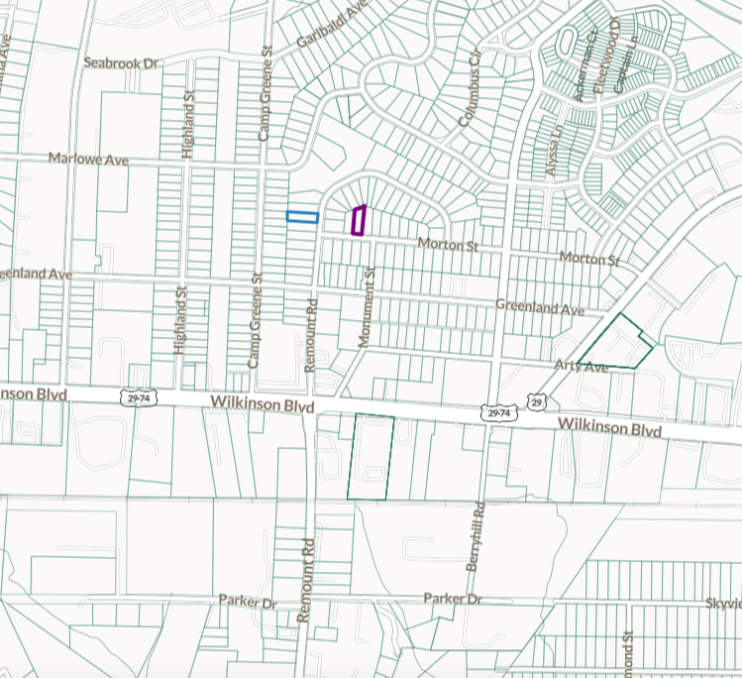
Displacement will halt our opportunity efforts
LYNX Silver Line proposed alignment 2/21
Notes:
Before we move on to our last set of interventions, I want to talk for a moment about displacement— I once heard a lecture where someone challenged Chetty’s findings saying in essence: moving to opportunity wont work because it’s not scalable. To an extent they were right, we can’t just move everyone from the crescent to the wedge. And no one is proposing this as our strategy, however... As our city grows rapidly, the issue we need to grapple with is not how to move everyone from the crescent to the wedge but what happens when the wedge moves to the crescent. Particularly as we work hard to increase economic mobility all around the city– indeed, when you look at parcel data for properties surrounding the proposed silver line stops on the west end, you’ll see the names of many developers and out of state holding companies… this light rail line is still years from realization and already many homes around closer-in stops are owned by investors … So, while we’re focused on moving to opportunity and increasing opportunity in neighborhoods, we need to focus on fighting displacement – one of the ways we can do this is by leveraging capital to ensure the benefits of public investments like these are shared by all. And its not just about transit investments, programs like federal opportunity zones and local opportunity corridors could be leveraged also. //>

Slide 21

We can reduce “stickiness” in intergenerational mobility by expanding access to postsecondary pathways
One Million Degrees takes a social determinants perspective to community college attainment. A recent randomized control trial showed their model significantly improved student outcomes.
We can incorporate social determinants frameworks into local initiatives on education and more.
UChicago Urban Labs RCT preliminary results
Notes:
Finally, we can interrupt intergenerational mobility through post-secondary education. The social determinants perspective can be incredibly useful in this work, helping our education partners think wholistically about services students might need to be successful. One model from an organization called One Million Degrees uses an adapted the social determinants framework, which you can see here, to increase community college persistence – early results from a randomized control trial show that OMD’s social determinants for education model increases persistence by nearly 50%. //>

Slide 22
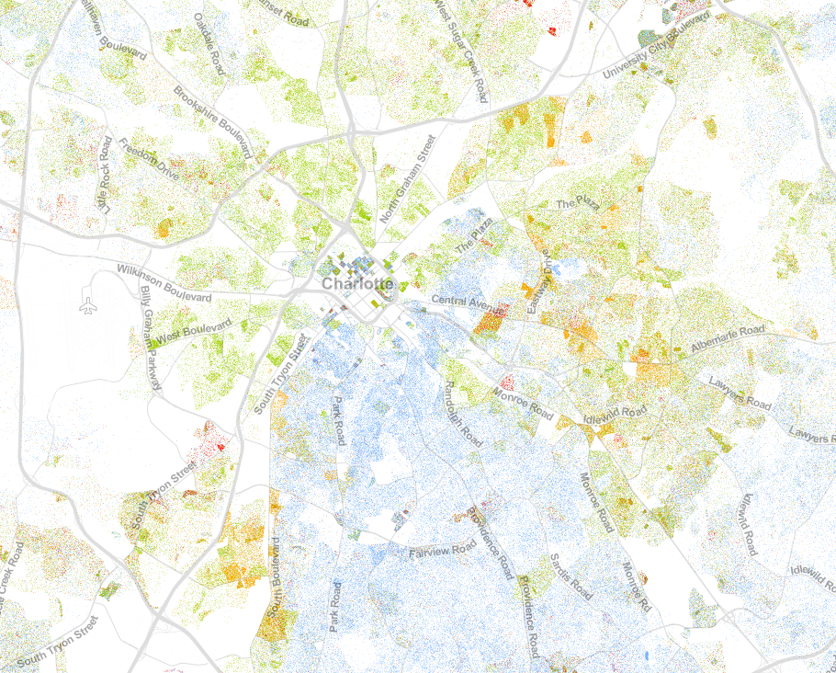
This is generational work, thanks for sticking with us.
AJ Calhoun
Senior Manager of Data and Evaluation
acalhoun@leadingonopportunity.org
Notes:
Often times working through the data and actions needed to solve Charlotte’s economic mobility crisis can feel overwhelming – and its longitudinal, too: even the best interventions won’t really bear fruit for years. We’ve got to unpack centuries of racism and disentangle rooms full of binders full of inequitable policies, but what y’all are doing today is starting to melt the ice that’s frozen our institutions for too long. For that I want to say thank you; thanks for being here today, for being engaged in this community, and for caring about this work – Charlotte’s got a long way to go if we’re going to improve outcomes for our most vulnerable citizens; in some cases we will work very hard for a very long time before we see change-– but if we’re patient, it will come. Every paper, every pilot, every gathering like this brings us just that much closer. We're not there yet, no city is -- Chetty and others leading the national dialogue on economic mobility will tell you the same, but if you listen they’ll also say: look at the folks in Charlotte, they are the ones really trying. Let’s stay focused. Thankyou.

Slide 23
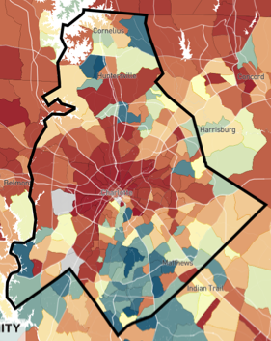
The most powerful map in Charlotte
Charlotte-Mecklenburg median ($33k)
<$10k
>$60k
Raleigh, Austin, Columbus, Denver, Nashville, Atlanta, Minneapolis, and Portland
Peer city median ($34k)
Overall national median ($44k)
22
Notes:
So we’d want to examine differences between conditions at a tract-level. We can start by
(a) begin with the OI atlas map of Mecklenburg county. Extract tracts where outcomes for children of low income parents were either (i) below the national average for everyone [44k] or (ii) below an average of similar outcomes for low income individuals in peer cities [34k] (remember from jan: our peers are Raleigh Austin Columbus Denver Nashville
Atlanta Minneapolis Portland)

Slide 24
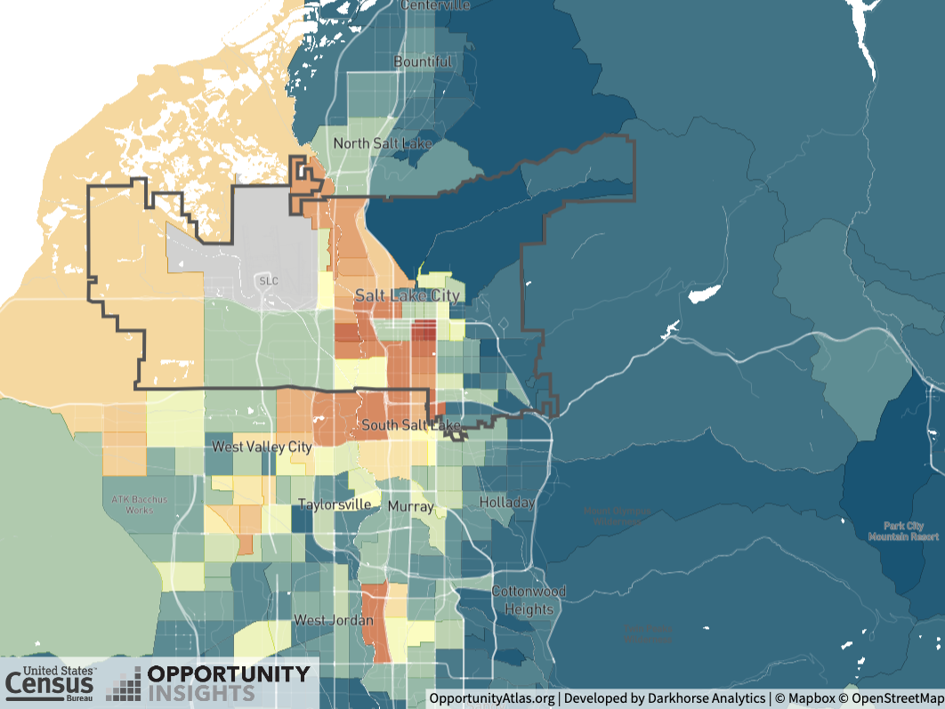
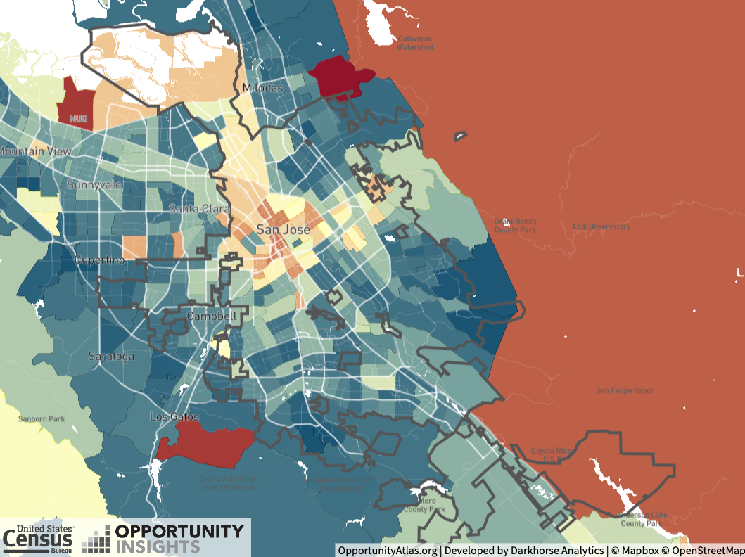
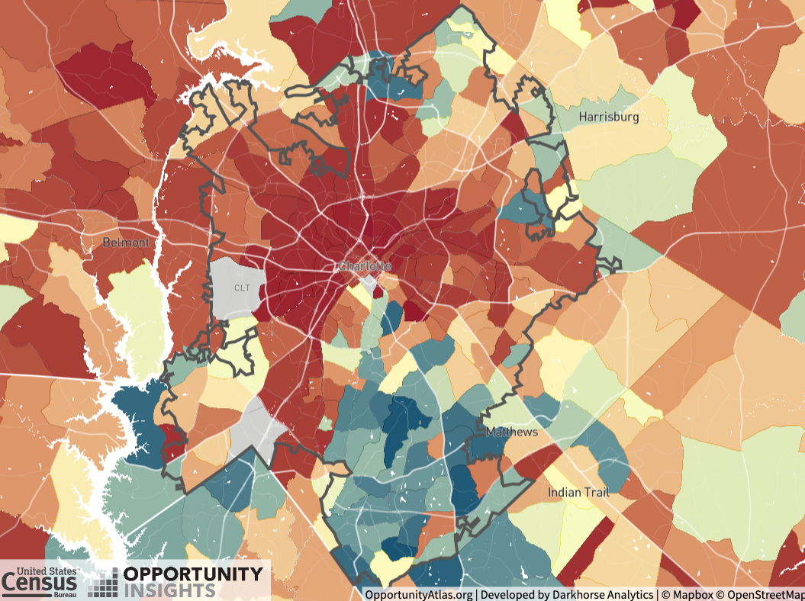
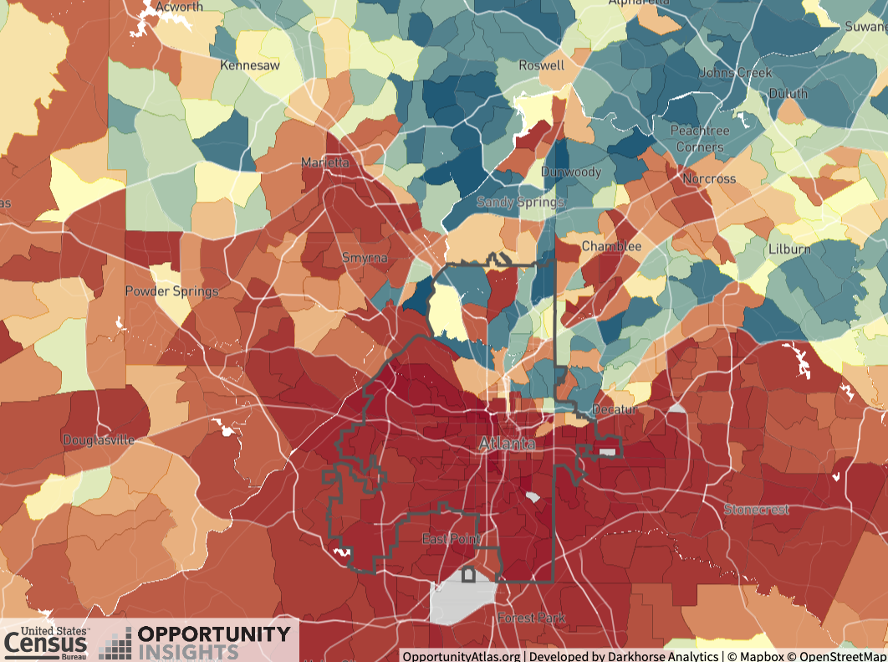

Slide 25
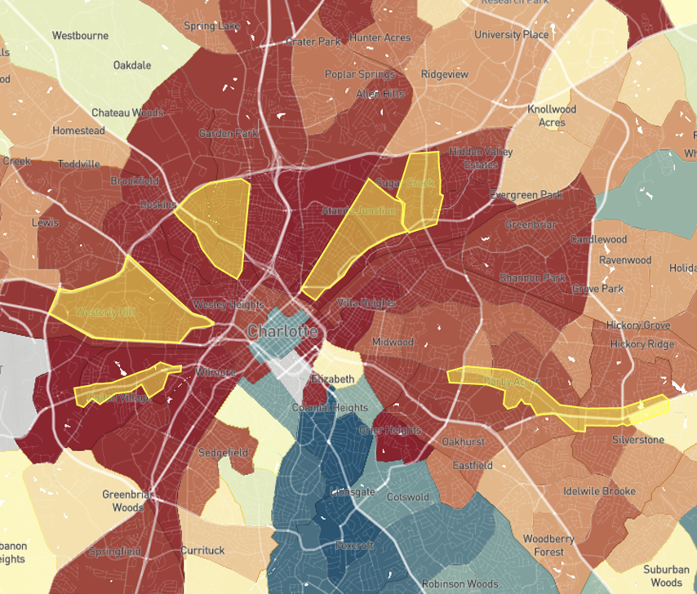
We can invest in neighborhoods to increase opportunity outcomes
(1) Family Structure
  Share single parent households (%)
  ACS/OI Atlas
(2) Educational Attainment
  Share of college grads (%)
  Source: QOL/ACS
(3) Educational Access
  Share of students attending neighborhood school by quality
  Source: NCSBE, QOL (Approx.), CMS (More accurate)
Household income for all children in Charlotte compared to corridors of opportunity locations
This is more difficult, but we are entering a new phase of possibility as capacity for measurement expands
  Invest in capacity building for small + grassroots organizations so we can get a better sense of what works.
Organizations like Results for America and Leading on Opportunity are leveraging new data to identify interventions likely to work:
  Expand access to systems navigators (e.g., community health workers)
  Leverage existing investments to maximize impact (e.g., TOD, Corridors of Opportunity)
View more strategies online:
  catalog.results4america.org
  leadingonopportunity.org
(4) Family Stability
Share of residents below the poverty line
  ACS/QOL
(5) Economic Access
  Commute time
  QOL/City
(6) Economic Attainment
  Share employed (%)
  ACS/QOL (Approx.), State Unemployment (Better)
(7) Segregation
  (a) income (b) race
  Theil Index, Dissimilarity
  ACS/Census/QOL
(8) Inequality
  Gini for MSA/CZ by race
  ACS/Census
(9) Social Capital (2 ways)
  Chetty: Common proxies
  LOO: Targeted area for future work
  QOL, neighborhood orgs
Notes:
And its not just about transit investments, here I’ve highlighted the City’s Corridors of opportunity program and online you can see similar maps of federal Opportunity Zones. These investments are just one of many strategies folks around the country are trying in an attempt to increase opportunity in neighborhoods. The variety of approaches speak to the complexity of this issue and the interconnectedness of its determinants. But we’re learning more every day about what works thanks to new data. To that end, one of the most important things we can do is to invest in capacity building for small + grassroots organization, by building capacity for evaluation we open up new ….
There are so many ways we can invest in neighborhoods to increase opportunity outcomes, but

Slide 26
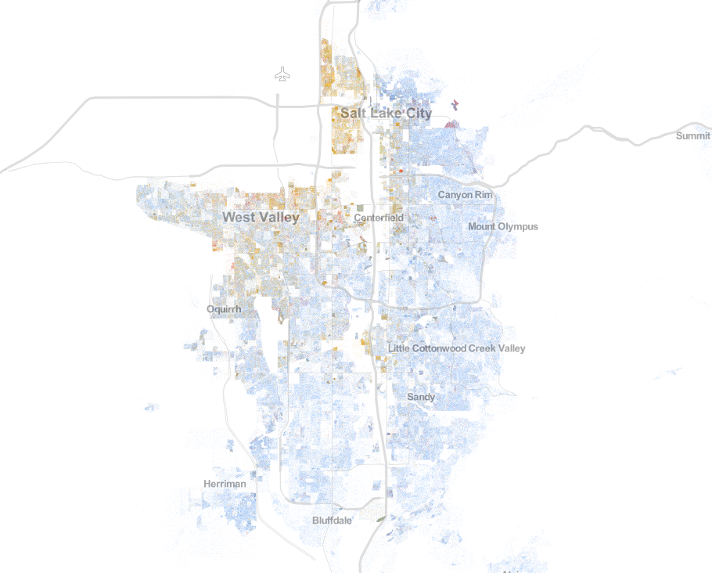
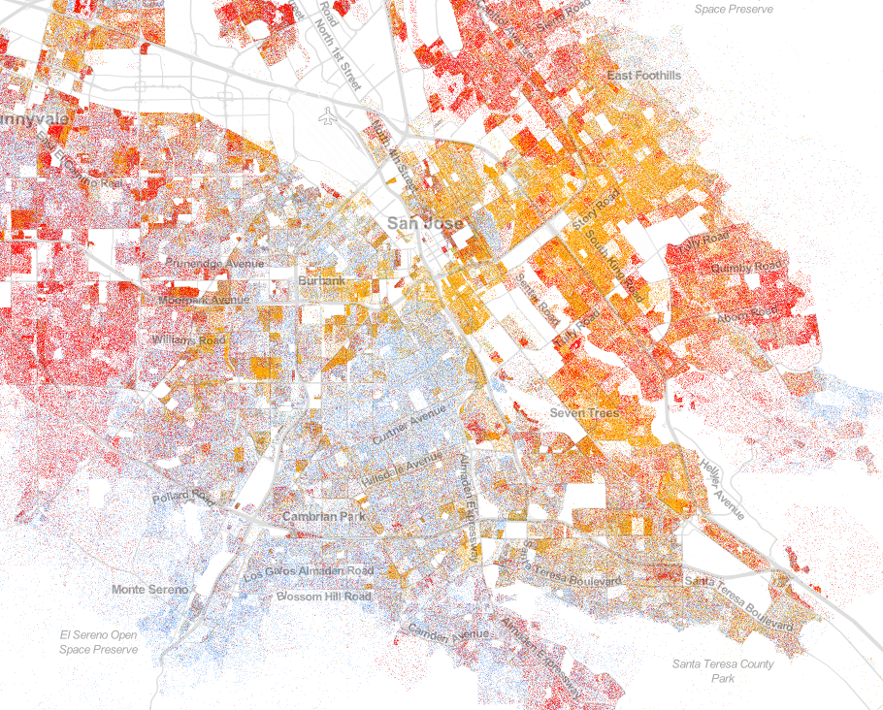
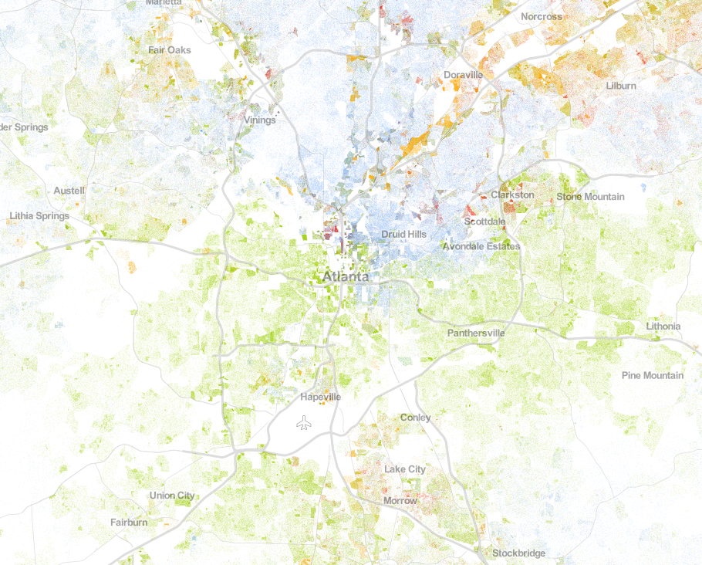
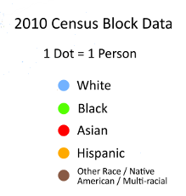
Segregation

