Slide 2

Identifying Social and Structural Determinants of Health Equity and Strategies for Taking Action
Academy for Population Health Innovation (APHI)
APHI Nexus 2021 Conference
09 April 2021
Presenter: Joseph Telfair, DrPH, MSW, MPH, FRSPH
Professor and Associate Dean for Public Health Practice and Research Karl E. Peace/Jiann-Ping Hsu Endowed Eminent Scholar Chair in Public Health
jtelfair@georgiasouthern.edu

Slide 3

“Health inequalities and the social determinants of health are not a footnote to the determinants of health
    They are the main issue"
From:
Social determinants of Health. 2nd ed .
Oxford, United Kingdom:
Oxford University Press,
2005

Slide 4
Equity, Structural, and Social Determinants (ESSD): Definitions, Explanations
- What We Know, Understand

Slide 5
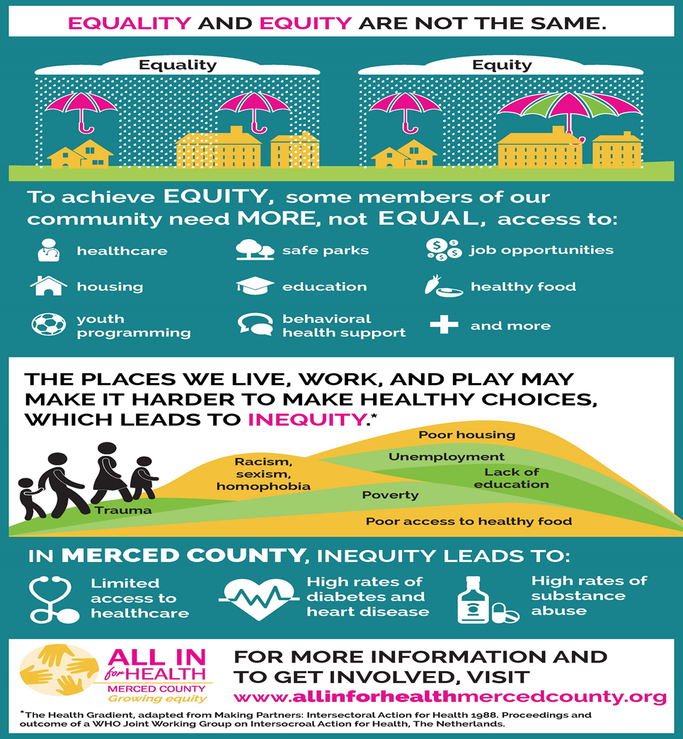
Question as Applied to
How we Define and Experience Health
Environmental
Social - Cultural
Economic
Political
Spiritual
Values and Rights
Overall Well Being

Slide 6
The Concept of Health Equity
Health equity is the fair distribution of health determinants, outcomes, and resources within and between segments of the population, regardless of social standing
“Health equity is a desirable goal/standard that entails special efforts to improve the health of those who have experienced social or economic disadvantage”
Health is necessary to overcome systemic/economic/social disadvantages
Sources: Whitehead, 1990; Working definition from the CDC Health Equity Working Group, October 2007; (Secretary’s Advisory Committee on National Health Promotion and Disease Prevention Objectives for 2020, 2030)

Slide 7
Understanding Burden
Health Equity and Health Disparities are intertwined
  Cannot have Equity without Justice
  Health Equity means Social Justice in Health
  Health disparities are the metric used to measure progress toward achieving health equity
  A reduction in health disparities [Burden] is evidence of moving toward greater health equity

Slide 8
So HEALTH EQUITY is
When all people, regardless of who they are, where they are from or what they believe, have the opportunity to attain their full health potential (Social Determinants)
Achieving health equity requires valuing all people equally with focused and ongoing efforts to address inequalities (Social Determinants)
Achieving Minimization/Elimination of entrenched patterns in the political, governmental and economic spheres that create, reproduce, and sustain inequalities (Structural Determinants)
Sources: Whitehead, 1990; Braverman, 2006; Dutta, 2015; Working definition from the CDC Health Equity Working Group, October 2007; Secretary’s Advisory Committee on National Health Promotion and Disease Prevention Objectives for 2020, 2030

Slide 9
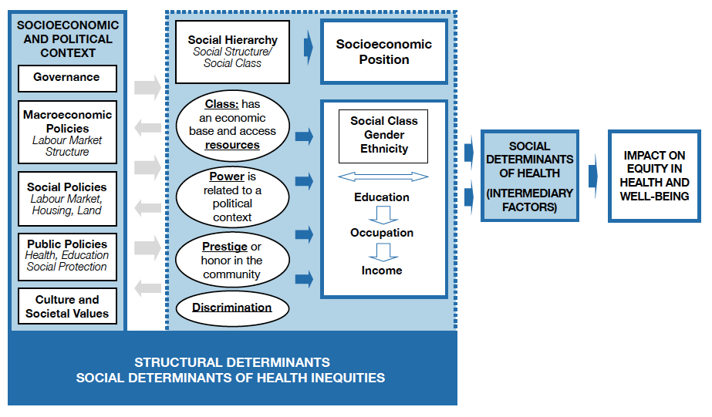
Structural Determinants of Health
Source: http://www.who.int/social_determinants/corner/en/

Slide 10
“Of all the forms of inequality, injustice in health care is the most shocking and inhumane.”
        From:
        Martin Luther King
        Associated Press (AP) newsgathering
        Saturday, March 26, 1966

Slide 11
Structural (Systemic) Inequality (1)
Is systems level privilege created by institutions within an economy.
These institutions include the law, business practices, and government policies.
They also include education, health care, and the media.
They are powerful socializing agents that tell us what we can achieve within the society
Structural inequality occurs even in a free market economy because of the laws and policies that form it
They create advantages for some and disadvantages for others
When the laws work against specific groups, inequality becomes part of the structure of the society.
Source: [added to, Paraphrased from] Amadeo, 2019

Slide 12
Structural Inequality (2)
Six major forms of structural (systems-level) inequality.
Education
Housing
Health care
Race
Gender
Media
Source: [added to, Paraphrased from] Amadeo, 2019

Slide 14
ESSD: Diverse Solutions

Slide 15
On Structural and Social Determinants & Inequities
“Why treat people’s illnesses without changing what made them sick in the first place?”
From:
World Health Organization’s Commission on Social Determinants of
Health Final Report (2008)

Slide 16
“One thing public health professionals have in common is a focus on population-level health…”
“Public health professionals have a major role to play in addressing these complex [ethical, legal, governmental, political, economic and social] health challenges, but to do so effectively they must have a framework for action and an understanding of the ways in which what they do affects the health of individuals and populations”
They must “Engage multiple sectors and community partners to generate collective impact”
Excerpted With Addition From: IOM (NAM) 2003 - Who will keep the Public Healthy?; DeSalvo, et al, 2017) – Public Health 3.0….Challenges of the 21st Century

Slide 17
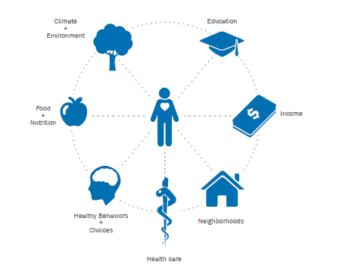
Health in All Sectors/Policies

Slide 18

Shaping Effective Equity Policy and Practice
Political Will
Knowledge Base:
Data as an
advocacy tool
Social Strategy

Slide 19
ESSD Solutions (1)
Solutions to structural and social inequality must:
  Address the entrenched, historical patterns of health inequities across the Local, State, National and the Global contexts
  Attention must be drawn to the role of the political economy in creating, reproducing, and sustaining these inequalities.
Source: [added to, Paraphrased from] Amadeo, 2019; Adapted from Navarro, 2007 & Dutta, 2015

Slide 20
ESSD Solutions (2)
The government and partners at all levels should ensure that all groups have equal access to the tools needed to improve their lives - includes
  basics such as water, food, and safety
  [If society has the resources] it should also include universal health care, equity in access to education, social and mental health services
This investment in human capital would bring everyone up to a basic standard.
Keep in mind structural patterns of organizing of local, national, and global economies shape the broad meanings of health care and the ways in which health care is constructed.
Source: [added to, Paraphrased from] Amadeo, 2019; Adapted from Navarro, 2007 & Dutta, 2015

Slide 21
Actions to Advance Equity Using Practice (1)
Your leadership, staff, and department can take the following actions to build a health equity movement:
  Collaborate with local, regional, state, and national partners from public health and social justice communities to advance health equity, and to help solidify a movement for progressive health equity practice
  Promote the work of others to make the case for investing in health equity work
  Work with community organizers to train health department and related staff on the principles and practices of community organizing
  Work with community organizers to include a message of health equity and social justice in their organizing efforts
Source: added to, Adapted From Strategic Practices Build a Health Equity Movement from Health EquityGuide.Org (retrieved January 25, 2018)

Slide 22
Actions to Advance Equity Using Practice (2)
Your leadership, staff, and department can take the following actions to build a health equity movement, cont:
  Support increasing the voice and influence of communities impacted by health inequities in policy change
  Focus on Root Cause Analyses and Solutions, e.g, Role of Discrimination
  Hold academic programs, provider networks and other public health system partners accountable for advancing health equity
  Listen and learn from broader social movements to better understand their issues, processes, and narratives, and how they build power and motivate their base
Source: added to, Adapted From Strategic Practices Build a Health Equity Movement from Health EquityGuide.Org (retrieved January 25, 2018)

Slide 23
Achieving Health Equity is a Moral, Ethical and Human Rights Imperative (1)
“It is an ethical responsibility and consonant with principles of human rights to give priority to action on important public-heath problems that differently affect those with fewer resources and/or greater obstacles to addressing problems”
“The case is moral – reducing health inequities and improving health is a duty and should have priority for governments and those with influence to improve health”
Excerpted From: Sir Michael Marmot Chair of the Commission on Social Determinants of Health (2005) Social determinants of health inequalities

Slide 24
Achieving Health Equity is a Moral, Ethical and Human Rights Imperative (2)
“The human rights principles of non-discrimination and equality also strengthen the conceptual foundation for health equity by identifying groups among whom inequalities in health status and health determinants (including structural and social conditions) reflect a lack of health equity”
“…..by construing discrimination to include not only intentional bias, but also actions with unintentionally discriminatory effects”
Excerpted With Addition From: Braverman (2010) Social Conditions, Health Equity and Human Rights

Slide 25
THREE PRINCIPLES OF ACTION (1)
Improve the conditions of daily life – the circumstances in which people are born, grow, live, work, and age
Tackle the inequitable distribution of power, money, and resources – the structural drivers of those conditions of daily life – locally, nationally and globally.
Source added to, adapted from: Strategic Practices Build a Health Equity Movement from Health EquityGuide.Org (retrieved January 25, 2018)

Slide 26
THREE PRINCIPLES OF ACTION (2)
Action #3
Measure the problem
Evaluate actions – focus on outcomes (utility)
Expand the knowledge base
Develop a workforce that is trained in the recognition and addressing the structural and social determinants of health
Raise public awareness and create mechanisms for engaged action addressing structural and social determinants of health
  achieving optimal wellbeing, social and economic attainment
Source: added to, Adapted From Strategic Practices Build a Health Equity Movement from Health EquityGuide.Org (retrieved January 25, 2018)

Slide 27
IN CLOSING

Slide 28
“We have never seen health as a right
It has been conceived as a privilege, available only to those who can afford it
This is the real reason the American health care system is in such a scandalous state”
From:
Shirley Chisholm
Member
U.S. House of Representatives,
1969 to 1983

Slide 29
Public Health and Our Partners have a vital role in the health equity movement
“However, even within the public health field, making an earnest shift toward health equity means having that “uncomfortable” conversation—we must also look inward and ask how our actions may perpetuate feelings of exclusion among the most vulnerable.
How can we build relationships of genuine trust?”
Source: G. C. Benjamin, MD 1 9 May, 2 0 1 5 in “Health Equity and Social Justice: A Health Improvement Tool”, in Views from the Field , Grant Makers in Health

Slide 30
THANK YOU

Slide 31


Slide 32
ADDITIONAL SLIDES

Slide 33
In Closing….Consider the Practice of…
Cultural Humility
  Has 3 dimensions useful for addressing Structural and Social Inequity:
    Lifelong learning & critical self-reflection — understanding that culture is, first and foremost, an expression of self and that the process of learning about each individuals’ culture is a lifelong endeavor
    Recognizing and challenging power imbalances for respectful partnerships — acknowledging and challenging the power imbalances inherent in our practitioner/client dynamics
    Institutional accountability — organizations need to model these principles as well

Slide 34
References (1)
Bialik, K. (October 6, 2017). Americans deepest in poverty lost more ground in 2016. Pew Research Center. Retrieved from http://www.pewresearch.org/fact-tank/2017/10/06/americans-deepest-in-poverty-lost-more-ground-in-2016/#
Anderson K.L., Kearney M.S., and Harris, B.H. (2014). Policies to Address Poverty in America – Introduction. The Brookings Institution. Retrived from https://www.brookings.edu/research/policies-to-address-poverty-in-america-introduction/
Belle, D., and Doucet, J. (2003) Poverty, inequality, and discrimination as sources of depression among US women. Psychology of Women Quarterly 27:2, 101-113
DeNavas-Walt, C., Proctor, B. D., Smith J.C. (2012). Income, poverty, and health insurance coverage in the United States: 2011. Report Census Bureau. Retrieved from https://www.census.govprod/2012pubs/p60-243.pdf

Slide 35
References (2)
Miech, R. A., Kumanyika, S. K., Stettler, N., Link, B. G. 2017. What is the current poverty rate in the United States? Center for Poverty Research. Retrieved from https://poverty.ucdavis.edu/faq/what-current-poverty-rate-united-states
Montgomery, L. E., Kiely, J. L., & Pappas, G. (1996). The effects of poverty, race, and family structure on US children's health: data from the NHIS, 1978 through 1980 and 1989 through 1991. American Journal of Public Health, 86(10), 1401-1405.
Munoz Boudet, A. M., Buitrago, P., Leroy De La Briere, B., Newhouse, D. L., Rubiano Matulevich, E. C., Scott, K., & Suarez-Becerra, P. (2018). Gender differences in poverty and household composition through the life-cycle: a global perspective.
NPR. 2017. The U.N. Looks At Extreme Poverty In The U.S., From Alabama To California. Retrieved from https://www.npr.org/sections/goatsandsoda/2017/12/12/570217635/the-u-n-looks-at-extreme-poverty-in-the-u-s-from-alabama-to-california

Slide 36
References (3)
Jacob A,. 2012 . Center for Poverty Research. Retrieved from https://poverty.ucdavis.edu/policy-brief/supplemental-poverty-measure-better-measure-poverty-america
Pendall, R., Davies, E., Freiman, L., & Pitingolo, R. (2011). A lost decade: Neighborhood poverty and the urban crisis of the 2000s. Washington, DC: Joint Center for Political and Economic Studies.
Phelan, J. C., & Chang, V. W. (2006). Trends in the association of poverty with overweight among US adolescents, 1971-2004. Jama, 295(20), 2385-2393.
Shambaugh J, Bauer L, and Breitwieser A. 2017. Who is poor in the United States? A Hamilton Project annual report. Retrieved from https://www.brookings.edu/research/who-is-poor-in-the-united-states-a-hamilton-project-annual-report/#footnote-1
Smeeding, T. M. (2005). Public policy, economic inequality, and poverty: The United States in comparative perspective. Social Science Quarterly, 86(s1), 955-983.

Slide 37
References (4)
The World Bank. 2018. Poverty. Retrieved from http://www.worldbank.org/en/topic/poverty/overview
T Premilla Nadasen December 21, 2017. The Washington Post. https://www.washingtonpost.com/news/made-by-history/wp/2017/12/21/extreme-poverty-returns-to-america/?noredirect=on&utm_term=.80a983a619f7
U.S. census Bureau. Number in Poverty and Poverty rate: 1959 to 2016. Retrieved from https://www.census.gov/content/dam/Census/library/visualizations/2017/demo/p60-259/figure4.pdf
World Health Organization. 2018. Poverty and health. Retrieved from http://www.who.int/hdp/poverty/en/
Hoynes, H. W., Page, M. E., & Stevens, A. H. (2006). Poverty in America: Trends and explanations. Journal of Economic Perspectives, 20(1), 47-68.
Whitehead, M (1992). The Concepts and Principles of Equity and Health. International Journal of Health Services, 22(3):429-45.

Slide 38
References (5)
Airhihenbuwa, C. O. (1995). Health and Culture: Beyond the Western Paradigm. New York: SAGE.
Dutta-Bergman, M. J. (2004). The unheard voices of Santalis: communicating about health from the margins of India. Commun. Theory 14, 237–263.
Dutta, M. J. (2008). Communicating Social Change: A Culture-Centered Approach. London: Polity.
Dutta, M. J. (2011). Communicating Social Change: Structure, Culture, Agency. New York: Routledge.
Dutta, M. J. (2015). Neoliberal Health Organizing: Communication, Meaning, and Politics. New York, NY: Left Coast Press.
Dutta, M. J., and Dutta, U. (2013). Voices of the poor from the margins of Bengal: structural inequities and health. Qual. Health Res. 23, 14–25.

Slide 39
References (6)
Good, B. J. (1993). Medicine, Rationality and Experience: an Anthropological Perspective. New York, NY: Cambridge University Press.
Kreps, G. L. (2001). The evolution and advancement of health communication inquiry. Ann. Int. Commun. Assoc. 24, 231–253.
Marmot, M. (2005). Social determinants of health inequalities. Lancet 365, 1099–1104.
Navarro, V. (ed.) (2007). Neoliberalism, Globalization, and Inequalities: Consequences for Health and Quality of Life. Amityville, NY: Baywood Pub.
Fleming, M.D., et. al, (2017) Patient engagement at the margin: Health care providers’ assessments of engagement and the structural determinant of health in the safety-net. Elsevier Ltd.
Anderson, Gerard, Horvath, Jane. (2004) The growing burden of chronic disease in America, Public Health Rep. 119 (3), 263-270

Slide 40
References (7)
Penman-Aguilar A. et al. (2016) Measurement of Health Disparities, Health Inequities and Social Determinants of Health to Support the Advancement of Health Equity. J Public Health Manag Pract. 2016; 22(Suppl 1): S33-S42.
Wall et al (2009). Evaluation of Community level interactions to address social and structural determinants of health: a cluster randomized controlled trial.
Dutta, M. (2016) Cultural Context. Structural Determinants, and Global Health Inequities: The Role of Communication
Lupton, D. (1994) Toward the development of critical health communication praxis. Health Health commun. 6, 55-67.
Dutta-Bergman, M.J. (2005) theory and practice in health communication capaigns: a critical interrogation. Health commun. 18, 103-122. Doi: 10.1207/s15327027hc102_1
Napier et al. (2014) Culture and health. Lancet 384, 1607-1639

Slide 41
References (8)
Black et al. (2015). The relationship between perceived racism/discrimination and health among Black American women: a review of the literature from 2003-2013. J. racial Ethn. Health Disparities 2, 11-20.
Ellis et al. (2015) “if you do nothing about stress, the next thing you know you’re shattered”: perspectives on African American men’s stress, coping and health from African American men and key women in their lives. Soc. Sci. med. 139, 14-23.
Heckler M. Report of the Secretary’s Task Force on Black & Minority Health Report of the Secretary’s Task Force on Black and Minority Health. Washington, DC: US Department of Health and Human Services; 1985.
Whitehead M. The concepts and principles of equity and health. Int J Health Serv. 1992;22(3):429–445.
Fiszbein et al. (2014) Social Protection and Poverty Reduction: Global Patterns and Some Targets, World Development. Doi: 10.1016/j.worlddev.2014.04.010.

