Slide 1
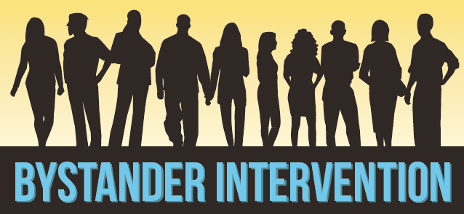
Presented by:
Annelise Mennicke, MSW, PhD
Associate Professor of Social Work
Community-engaged evidence-based approaches

Slide 2
Bystander intervention is recognizing a potentially harmful situation or interaction and choosing to respond in a way that could positively influence the outcome.
Gives everyone in the community a role to play in violence prevention, with concrete actions.

Slide 4
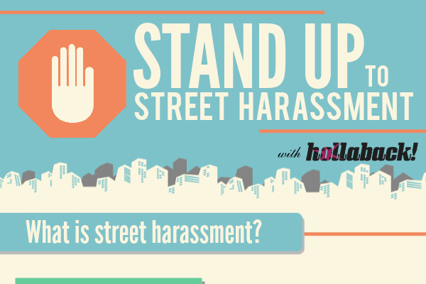
Progression of Bystander Intervention
Middle Schools
High Schools
Communities
Colleges
Alcohol
Sexual Violence
Dating Violence
An emerging field!
Bullying
Microaggressions
Street Harassment

Slide 5
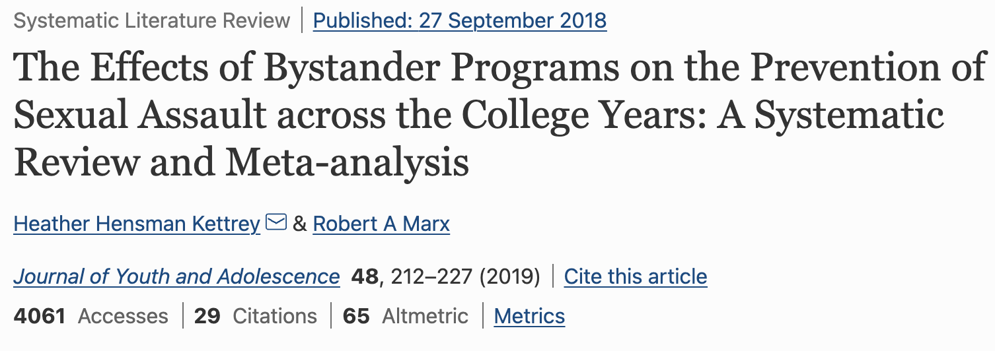
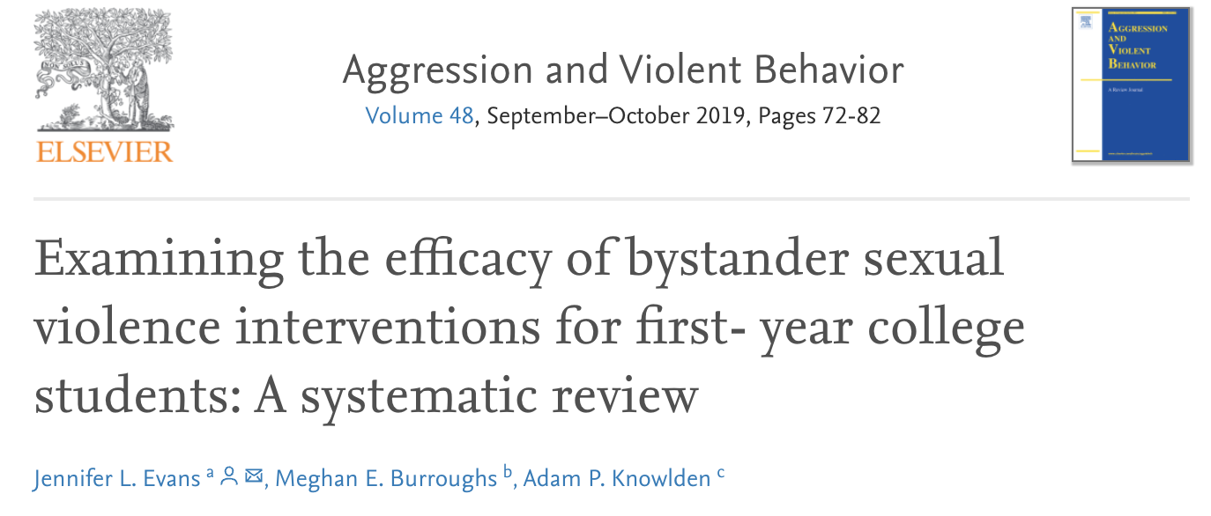
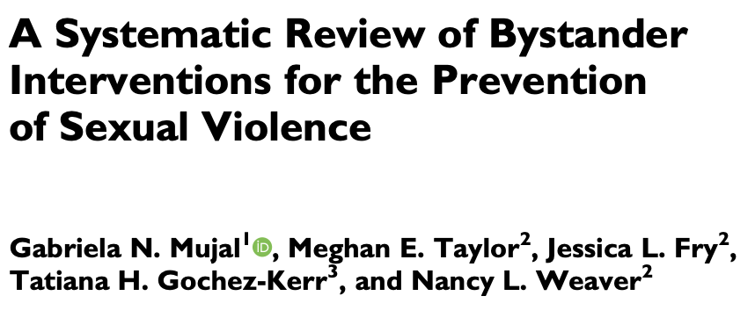
Evidence for Bystander Intervention Programs
Bystander intervention training improves
Self-efficacy
Bystander intentions
Bystander Behavior

Slide 6
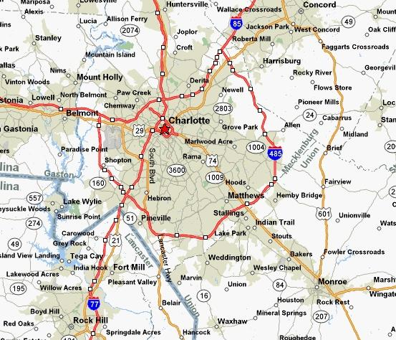
Green Dot
Effective at…
Reducing acceptance of myths related to dating violence and sexual violence
Increasing bystander behaviors
Preventing victimization AND perpetration of…
Sexual violence, sexual harassment, stalking, and dating violence
In an RCT across 26 high schools in Kentucky, Green Dot was associated with a 50% reduction in sexual violence perpetration!
Coker et al., 2016; Coker et al., 2015; Coker et al., 2011; Coker et al., 2017

Slide 7
BUT…does Green Dot work among high risk groups?
Youth who witness parental IPV?
Mennicke et al., 2021

Slide 8
Such Potential!
Bystander Intervention…
An evidence-based approach for engaging communities in violence prevention
Can be complimentary to existing efforts such as VIP program
Often universally applied, but has targeted effects among the more vulnerable
May be applied to violence plaguing Char-Meck area, including gun violence, human trafficking, etc.

Slide 9
Application
Notes:
https://www.polleverywhere.com/free_text_polls/pc36F3cwM1ZUWI3GJAIis

Slide 10
What do you think were some barriers to intervening for people on the train?
What is one thing you can do this week to be a better bystander?

Slide 11
Questions?

Slide 12
Contact Information
Dr. Annelise Mennicke
amennick@uncc.edu

